Slide 1
Getting the Most Out of GSA eBuy & eBuy Open Doug DuBois
Notes:
Hi I am Doug DuBois and I am part of the Product Owner team for eBuy. Today I will be demonstrating how buyers use eBuy to generate RFQs (or RFIs) for submission of quotes for commercial products and services and also how to use a separate but related system - eBuy Open - for market research in preparation for future RFQs. This is a lot of ground to cover so I will go quickly through some slides but wanted to make sure that they are documented in detail so that you can use slides as a reference guide when using the system yourselves.

Slide 2
Learning Objectives
After participation, attendees should be able to:
Describe what eBuy is used for
Use eBuy to orchestrate the end to end process of quote creation to the applicable award decision activities
Use eBuy Open for market research of RFQs from across government agencies.
Notes:
I will be doing an end to end demo of the creating an account and going through the process of creating and processing an RFQ.
After participating in this training, attendees should be able to:
Describe the purpose and benefits of GSA eBuy
Identify the steps to register for eBuy, set up multi-factor authentication, and log-in
Describe the steps to prepare a Request for Quotation (RFQ) in eBuy
Identify the process for evaluating quotes in eBuy
Identify the process for awarding quotes in eBuy

Slide 3
Agenda Topics
Overview of eBuy, and its usage.
Register or setup an account.
Set up multi-factor authentication (MFA), and PIV/CAC.
Create and post a sample RFQ.
Evaluate and award.
Other RFQ scenarios.
Access and use eBuy Open.
Notes:
This will include all of these topics:
An overview of eBuy, and its usage
How to Register an account
Setting up multi-factor authentication and PIV/CAC card
How to create and post a sample RFQ
Evaluation and award steps
Other RFQ scenarios
Access And use of eBuy Open

Slide 4
What is eBuy?
“GSA eBuy is a powerful and intuitive acquisition tool used by thousands of US federal agencies and military services worldwide to achieve required competition, best pricing and value. GSA eBuy saves you time and money - all while keeping you FAR compliant.”
Notes:
eBuy is an RFQ system that lets federal buyers request quotes and prospective vendors submit quotes or responses. It’s used by thousands of US federal agencies and military users worldwide.
Very importantly, using eBuy achieves the required competition, best pricing and value and ensures compliance with the FAR.

Slide 5
What is eBuy used for?
Quotes for services
Obtaining volume discounts beyond contract pricing
Complex requirements, or combinations of products or services
Determining sources of supply, via RFIs
Obtaining quotes directly against BPAs
Notes:
eBuy is the sister system to GSA Advantage! and has been around since 2001. GSA Advantage is mainly used for purchasing products (although some services are procured there) whereas eBuy is primarily used for procuring Services or more complex combination of products and services. eBuy is used for:
is used for:
Quotes for services
Obtaining volume discounts beyond existing contract pricing.
Procuring complex requirements that require a combination of products and/or services
Determining sources of supply by issuing an RFI
Obtaining quotes against BPAs

Slide 6
What is new in eBuy?
MAS Consolidation
User experience improvements
Functionality moved to modals (overlays)
Redesigned flow
Pages with print optimized styling
PO creation enhancement
Streamlined PIV/CAC card registration
Bulk upload of line items to an RFQ
No quote reason for eBuy Contractors
Interim “Interested” RFQ response
Notes:
A couple of years ago, eBuy went through its first major refresh in well over a decade. The refresh included an improved user-centric design. Many functions that used to require refreshing the page, are now handled in modals. The difference in speed is phenomenal; users don’t have to wait for the entire page to reload before they toggle something. Now registering you government PIV card is done with a few clicks of a button during new user registration. There’s the addition of being able to bulk upload multiple line items to an RFQ instead of relying on manually one by one. We also included a feature to get more meaningful information from suppliers on why they choose NOT to submit a quote.
There is a very recent change not shown in these slides where vendors can indicate they are “Interested” in quoting as a sort of interim notice to COs that they will likely submit a quote before the close date.

Slide 7
eBuy Activity in FY 2022
~48,833 RFQs representing $20.3B estimated award value.
12,404 RFQs were small business set-asides
Average quotes per RFQ: 3
87 RFQs over $1M in award value (37 in Sept. alone)
Top 4 posters: Air Force, Navy, GSA, Army
Top 3 commodities: IT (2GIT), Hardware, Furniture
Notes:
This just shows some of the latest stats on usage of the system from FY 2022
GSA is in the top 10 users of its own system, with the number 3 position. 3 of the top 4 (Airforce, Navy & Army) are held by the Department of Defense. IT by itself is almost 12,000 RFQs, which is about ¼ of the total activity. “Set-aside” doesn’t mean everything not-set-aside was for large – it just means that set-asides were for small business exclusively. The remainder were open to all, and may have been awarded small or awarded large. The 3 quotes per RFQ thing helps reassure folks that they won’t be flooded with quotes, thereby making eBuy MORE work than just going to 3 vendors
FY2022 showed a shift in where the most RFQs were posted. In 2020, IT, OASIS, law enforcement, scientific and furniture were the top 5. In 2021, IT remained number 1, with furniture and scientific taking 2 and 3; and then office supplies and industrial products. Also, MAS, the consolidated schedule, is #1, though that is a technicality because of all the cross posting.

Slide 8
What do buyers post RFQs for?
Office furniture
Flat panel monitors
Water treatment services
Shredding services
Tai chi instructor
Crane suspended man basket
Screws nails and staples
Section 106 Cultural Resource Survey - Native Village of Mekoryuk, Alaska (set-aside, awarded)
Theodolite
Notes:
eBuy can be used for a broad range of requirements.
A random sample of reviewing RFQ posts showed postings for:
Office furniture
flat panel monitors
water treatment services
shredding services
.

Slide 9
“New User” Registration, MFA and Login
Notes:
I was going a little fast through some of those slides so that I have time to got through the Buy process starting with registering for an account. You must be a registered user to post an RFQ.

Slide 10
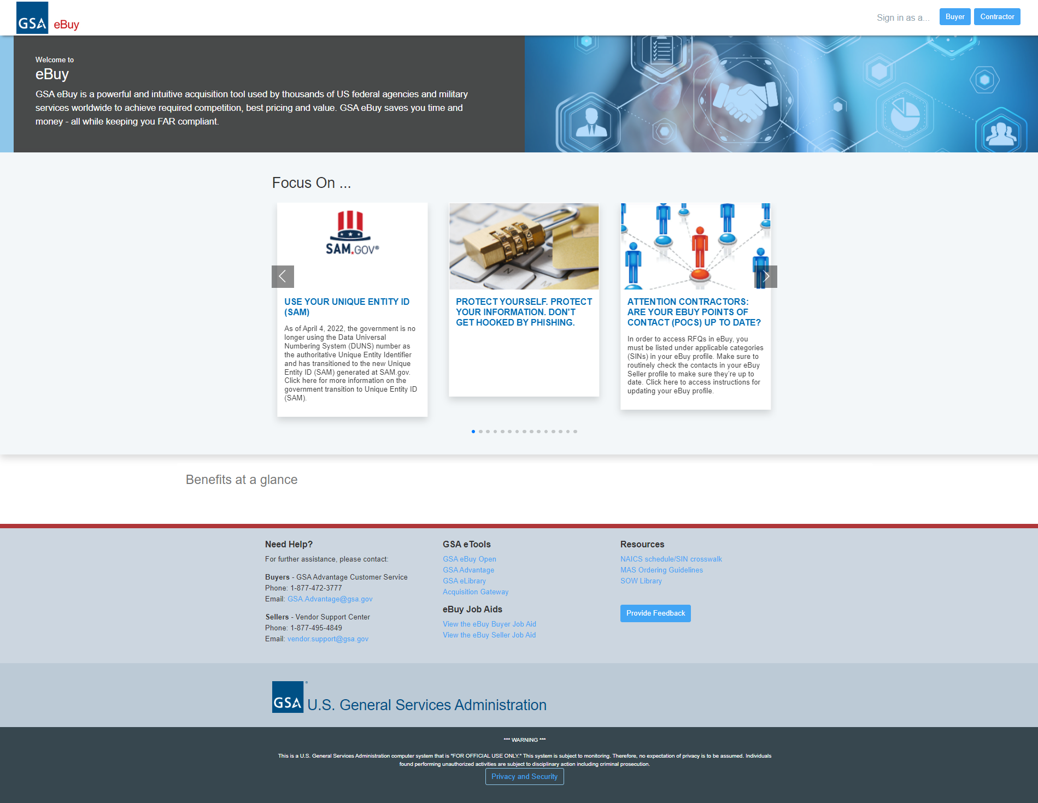
“New User” Registration
Notes:
Here is the eBuy Homepage The URL is ebuy.gsa.gov
This is what you see when you go to eBuy.
Middle of the screen has scrolling banners of information.
Bottom portion of the page has information to support services, instructional job aides and additional helpful resources.
But the main takeaway is that you first have to indicate if you are a Buyer or Contractor. Our demo today will follow the Buyer path.

Slide 11
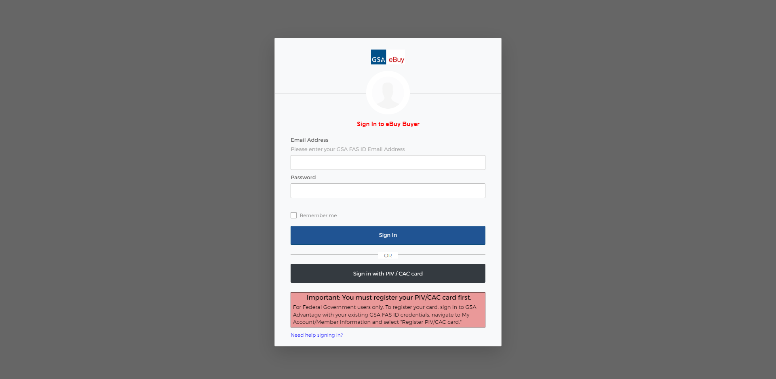
“New User” Registration
Notes:
This is the sign-in screen if you are already a registered user.

Slide 12
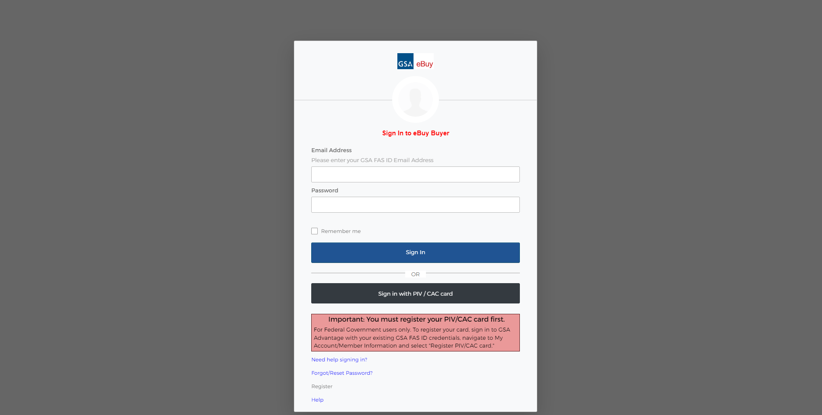
“New User” Registration
Notes:
In order to register, or reset your password, you need to click “Need help signing in?” at the bottom. The “Forgot/Reset Password?” “Register”, and “Help” links will appear. For this example, we are going to register for the first time. Click “Register”

Slide 13
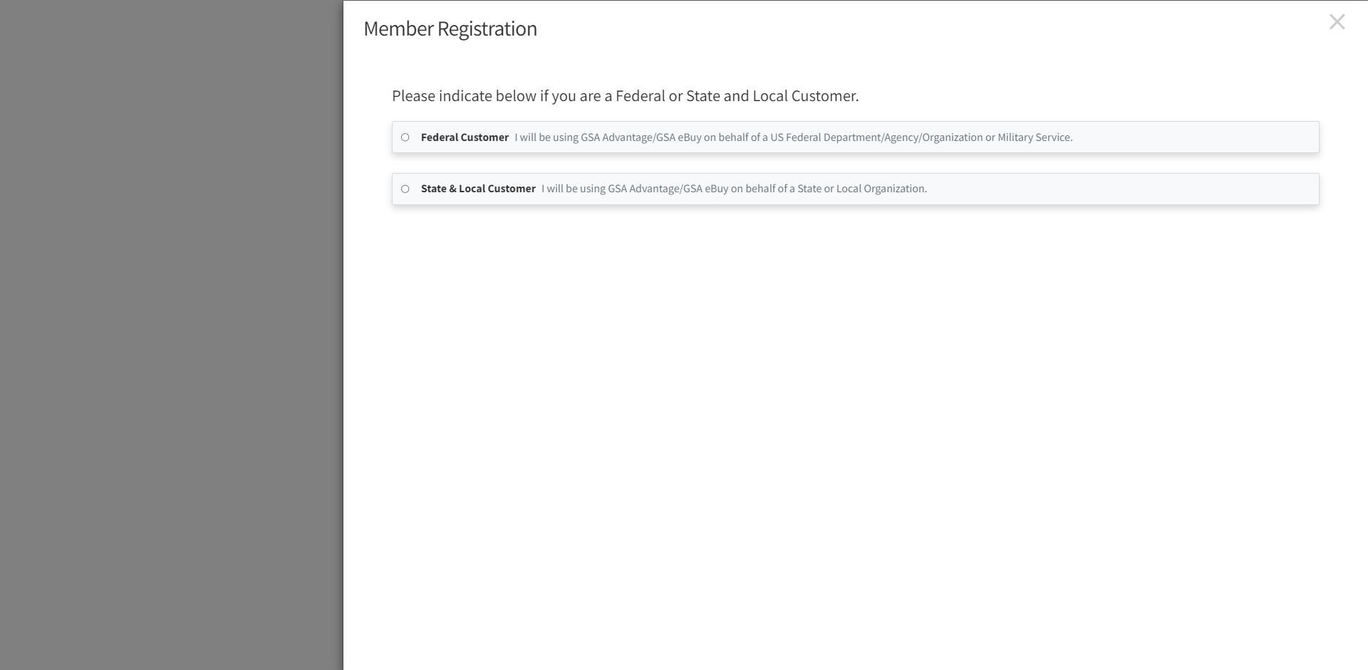
“New User” Registration
Notes:
We’re going to follow the path for Federal government registration. Click the radio button for “federal customer” and you will be prompted to move forward.

Slide 14
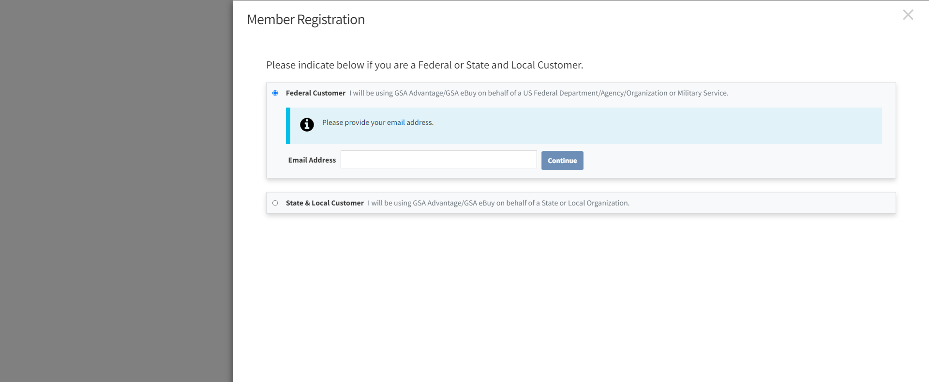
“New User” Registration
Notes:
You’ll be asked to enter your e-mail address in the field that pops up.

Slide 15
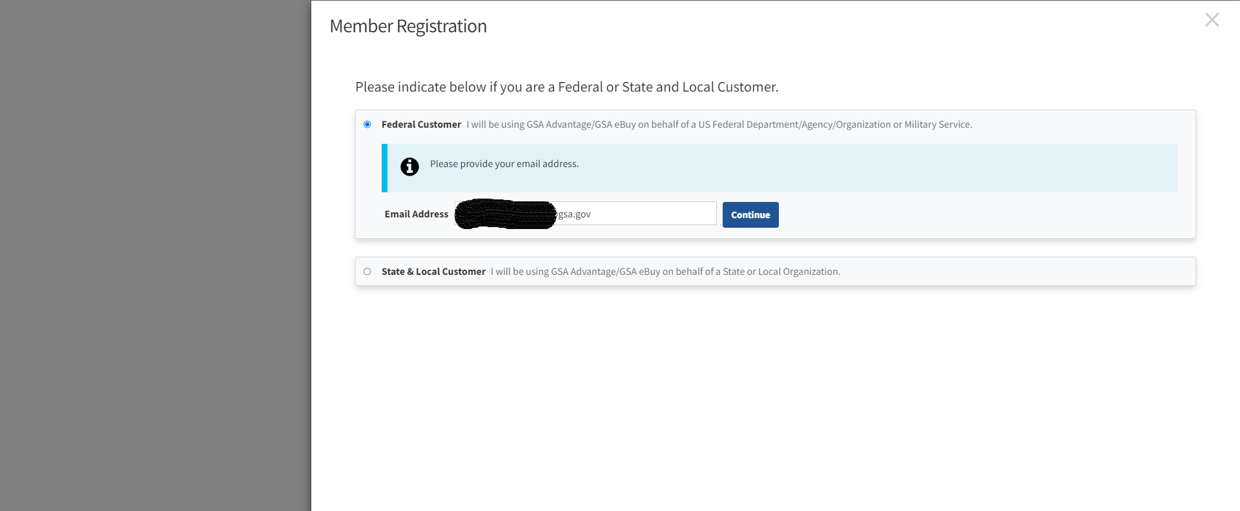
“New User” Registration
Notes:
Enter your email address (it MUST be a valid government or military email address), and press “continue”.

Slide 16
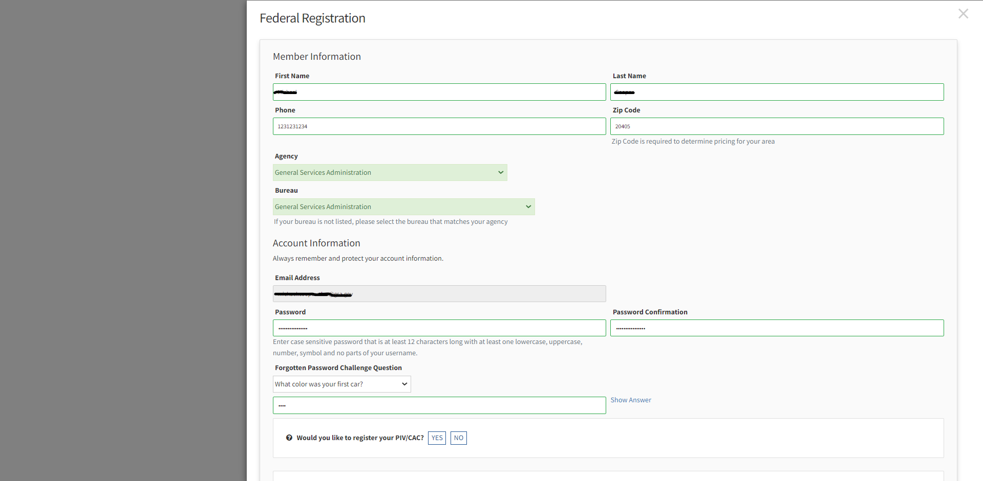
“New User” Registration
Notes:
You will complete a few brief fields for your new account.
Type your first name, last name, business phone number and zipcode.
You will also add your Agency, and bureau.
Still on the same screen, look for where it indicates password.
The screen will auto-fill your email address. This was brought over from when you supplied it earlier.
So you will enter your password once, and then a second time for confirmation.
You will need to select a Challenge Question and provide an answer. This is for any circumstance that you may have forgotten your password and need to reset it.
Next, at the bottom is where you indicate you want to register your PIV/CAC card. Once your card is registered, you will be able to login to eBuy using just your PIV/CAC card. The only thing you have to do is select YES.
Scroll down a little further.

Slide 17
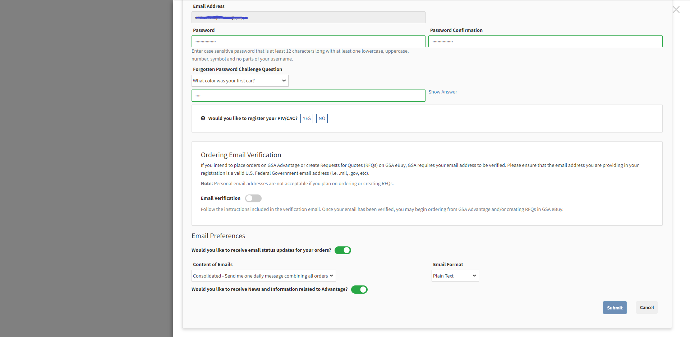
“New User” Registration
Notes:
If you plan on placing orders on GSA Advantage, GSA requires you verify your email address. This is where the system checks your email address to ensure it is a valid US Federal Government issued email address. This step happens automatically if you selected yes to register your PIV/CAC. So what you see here will not come up if you selected ‘yes’. If selected “no” to register your PIV/CAC you will have to follow the instructions for verifying your email address. An email will be sent to your federal email address with more instructions.

Slide 18
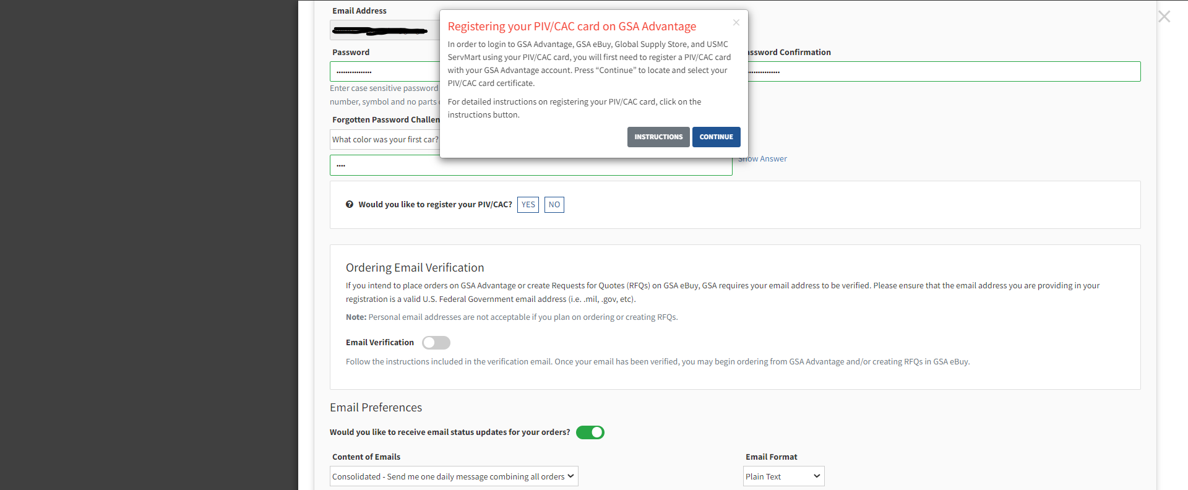
“New User” Registration
Notes:
So, after selecting YES to PIV card registration you have the option to review detailed instructions of what we are currently discussing.
Or just click CONTINUE

Slide 19
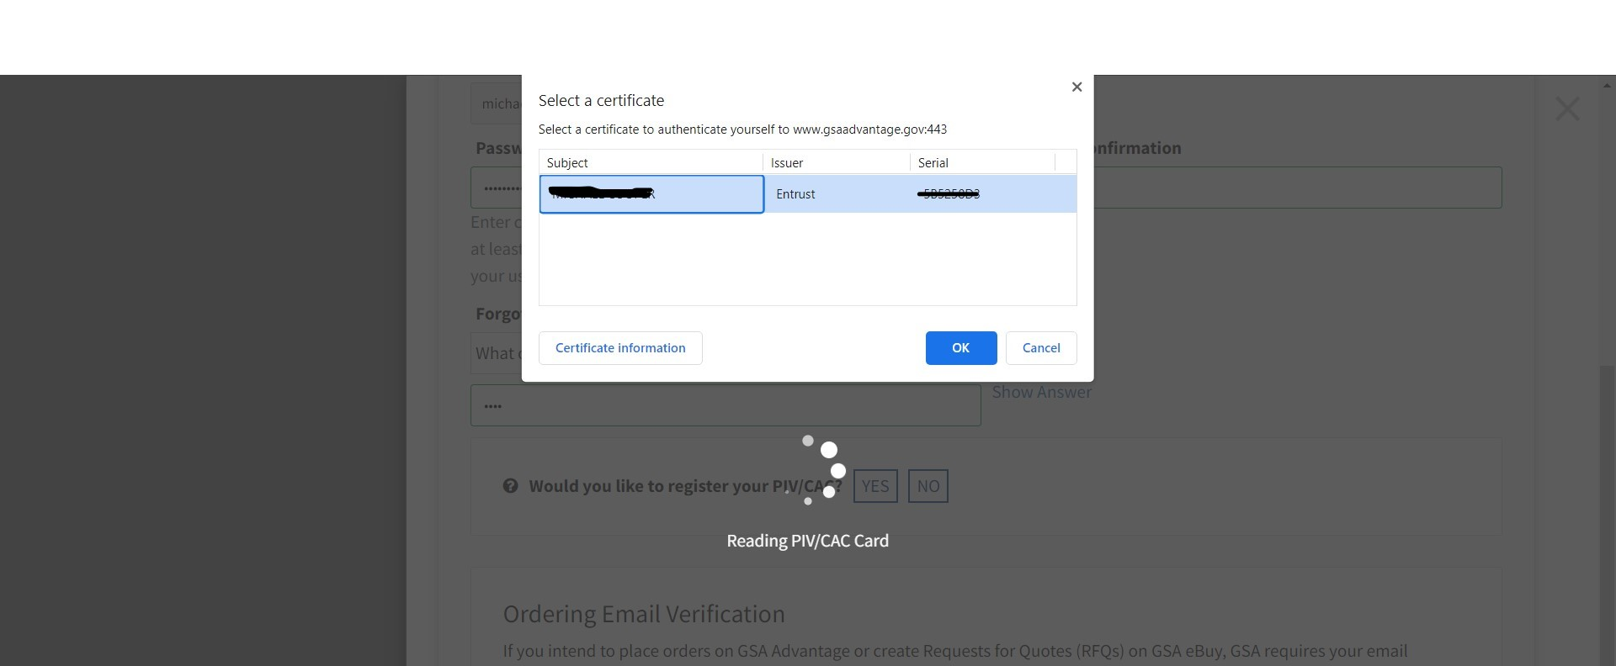
“New User” Registration
Notes:
Here you will have to select the correct certificate. There are cases when an individual has more than one. In this example there is only one to select, so select it and click OK.

Slide 20
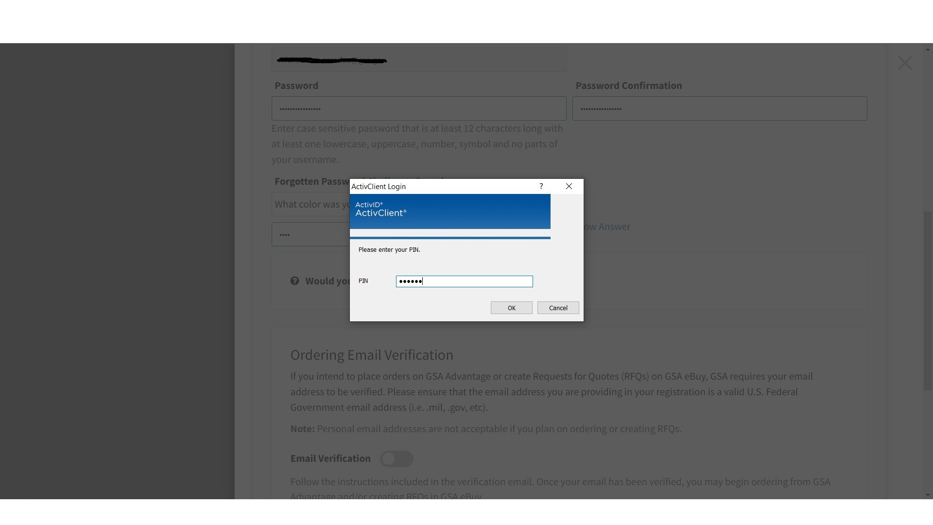
“New User” Registration
Notes:
Enter your PIN number and click OK

Slide 21
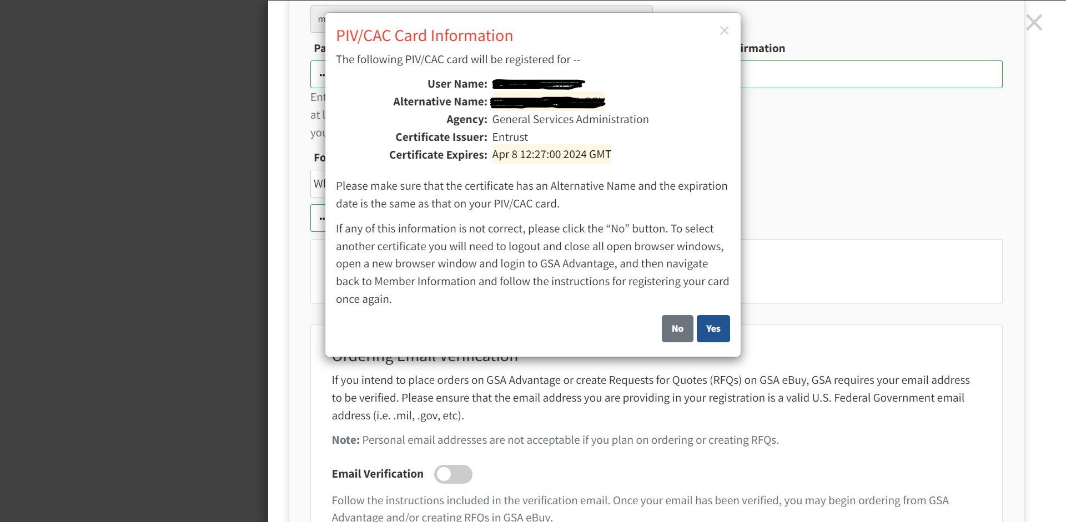
“New User” Registration
Notes:
eBuy will read the certificate information and present it to you. Verify that everything is correct. If this is the certificate you wish to use, click “yes”. If not, or if the information is not correct, click “no”

Slide 22
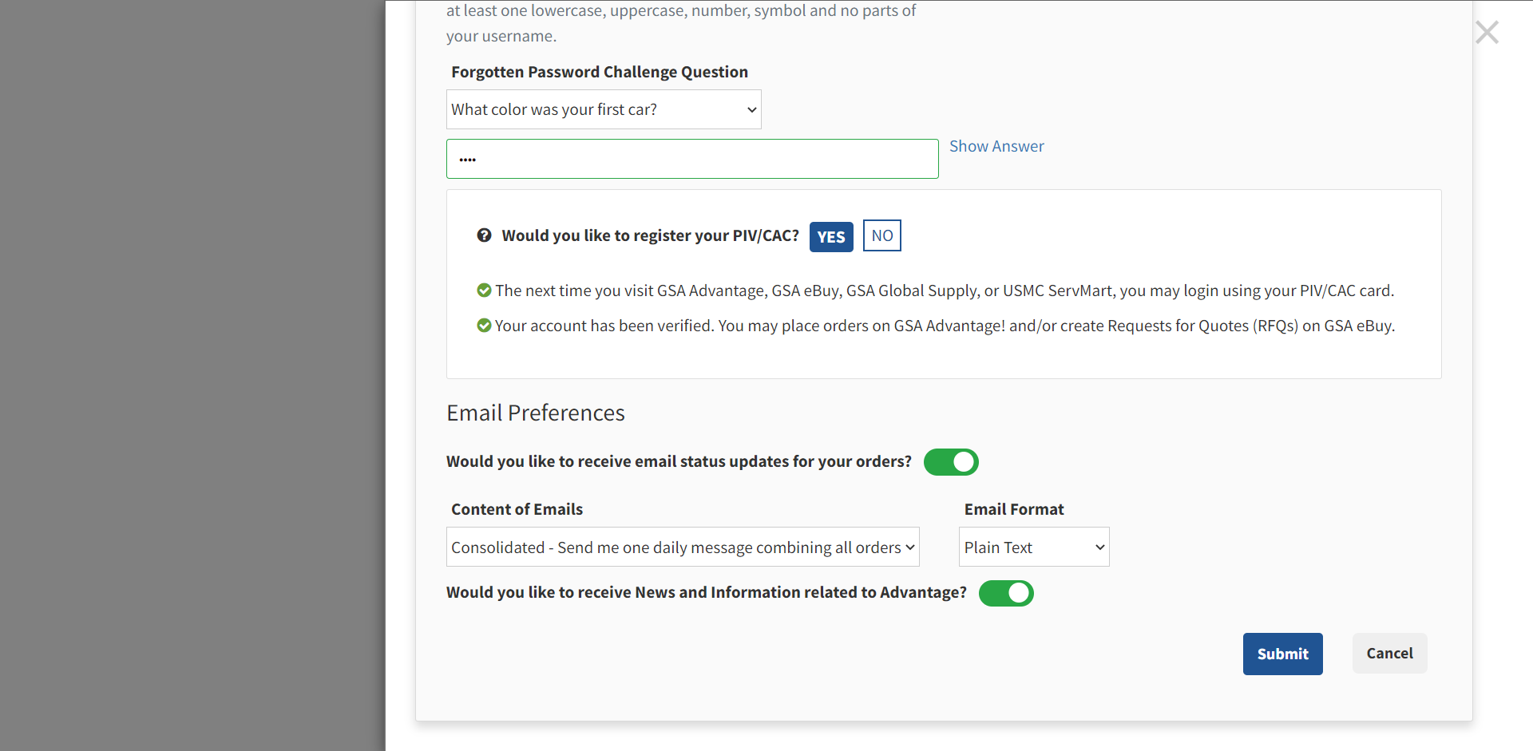
“New User” Registration
Notes:
Here you can indicate if you want to receive email status updates on the future orders you will place, and if you want to receive any News and Information related to Advantage. Click Submit.

Slide 23
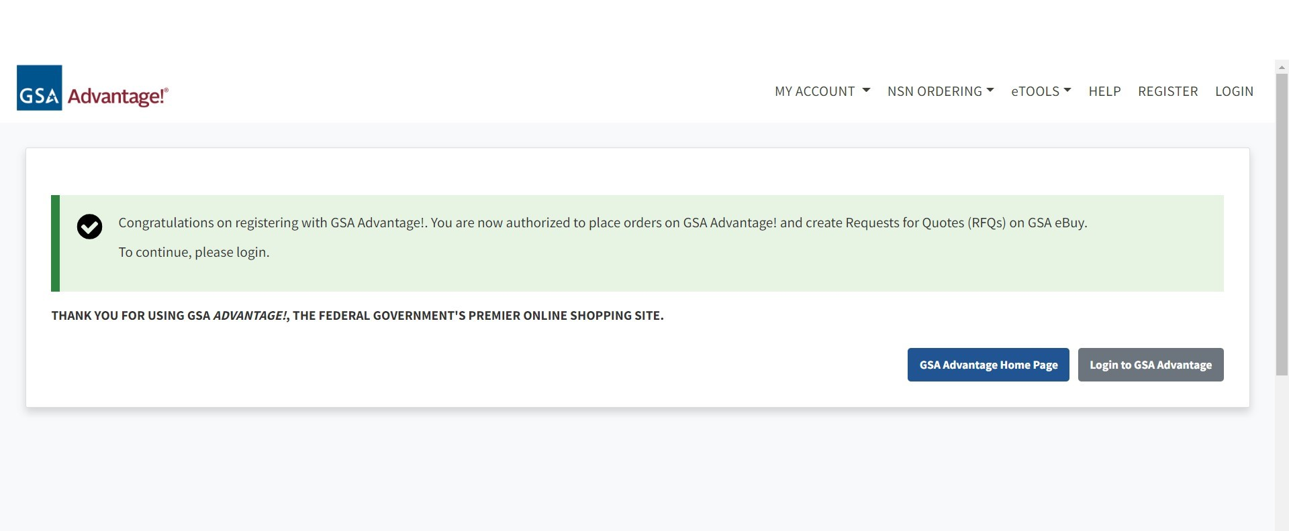
“New User” Registration
Notes:
Registration is complete. That was a lot of slides to cover registration with PIV Card and it should be familiar to most people but we want to make sure that people understand the process for the PIV card registration.
Now you could just click on “eTOOLS” in the upper right corner; and then eBuy to Log in. But I will also quickly show slides of registration process if you do NOT have a PIV card.

Slide 24
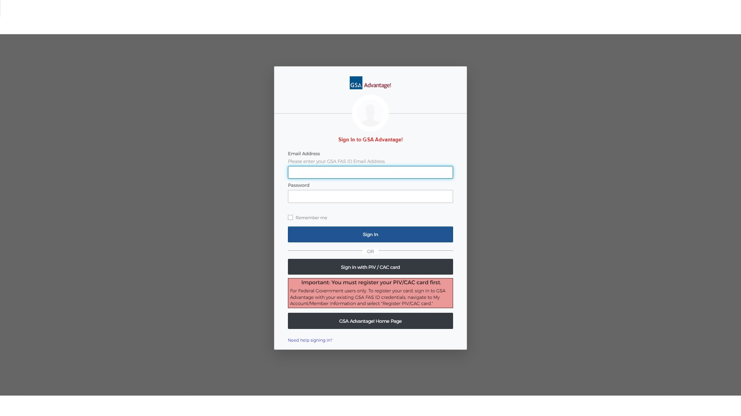
Multi-factor Authentication
Notes:
You are now at the login screen. And there are multiple option for Multi Factor Authentication (MFA)
.

Slide 25
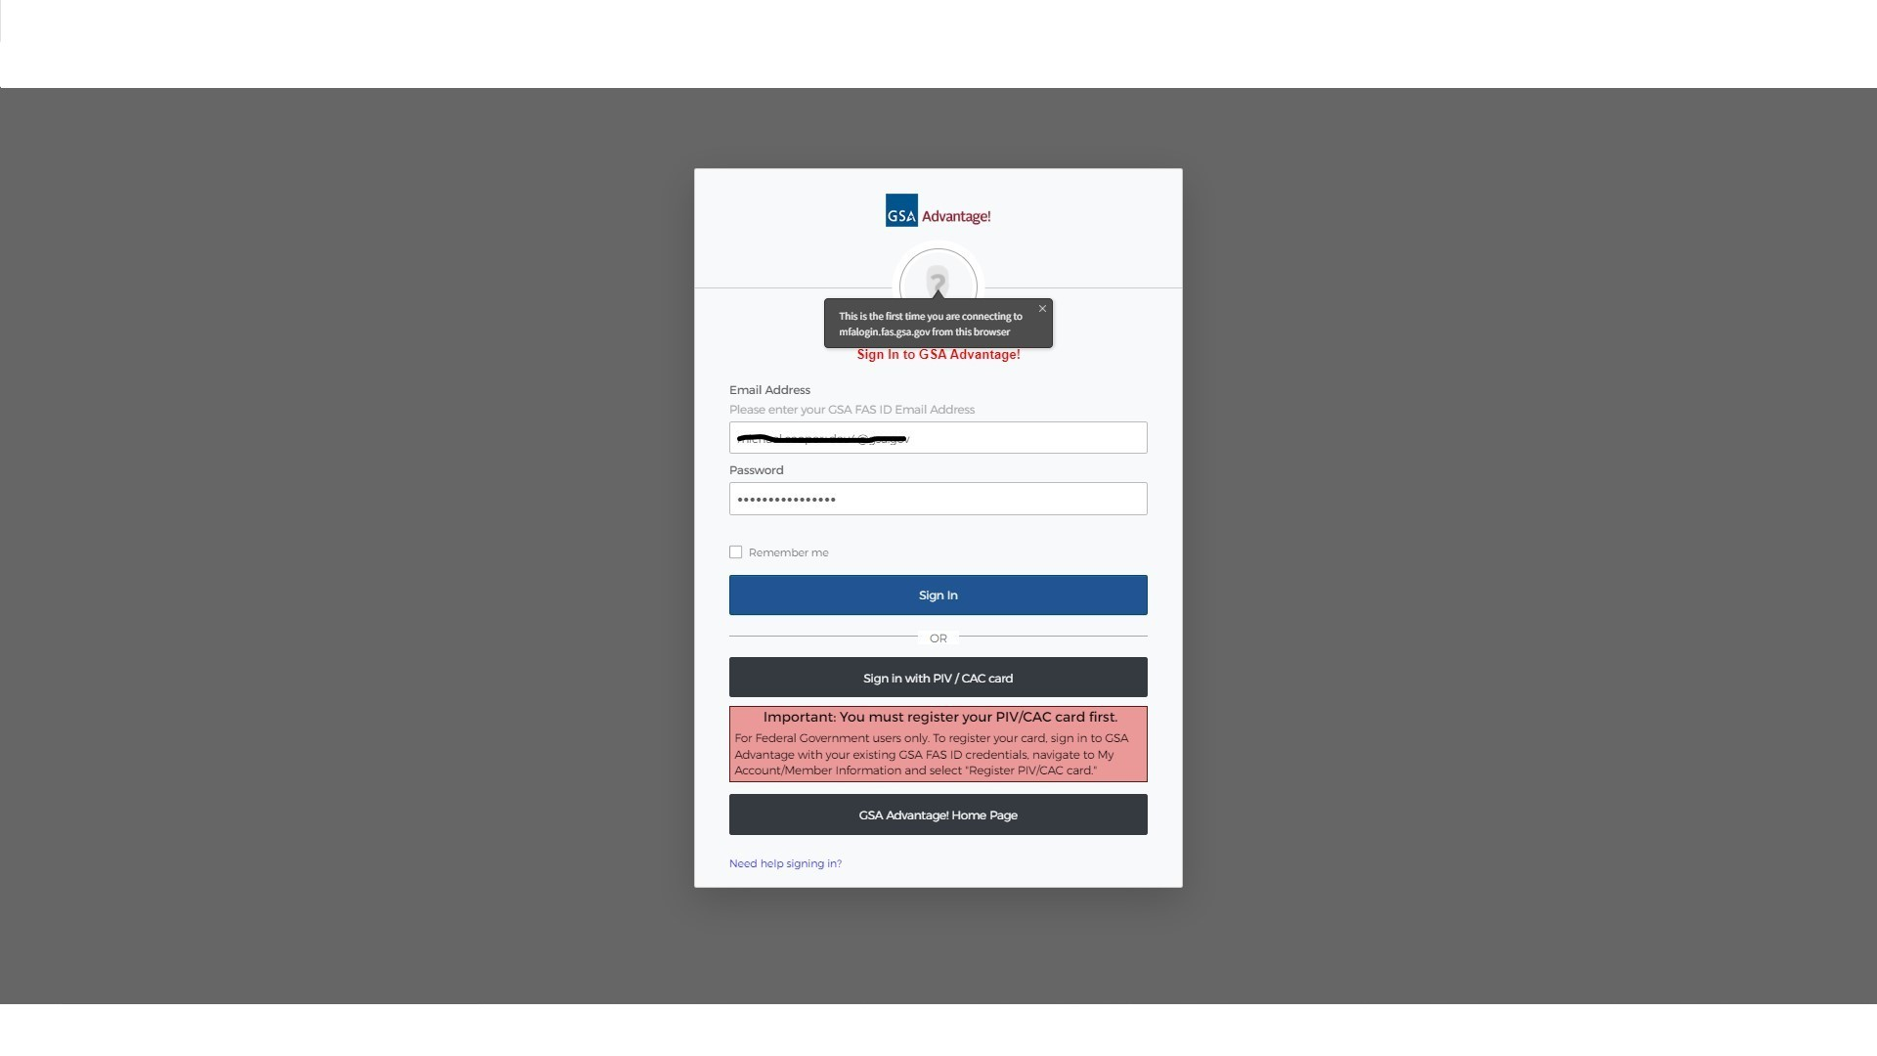
Multi-factor Authentication
Notes:
But start with entering your valid gov or mil email address and password you provided during registration.
.

Slide 26
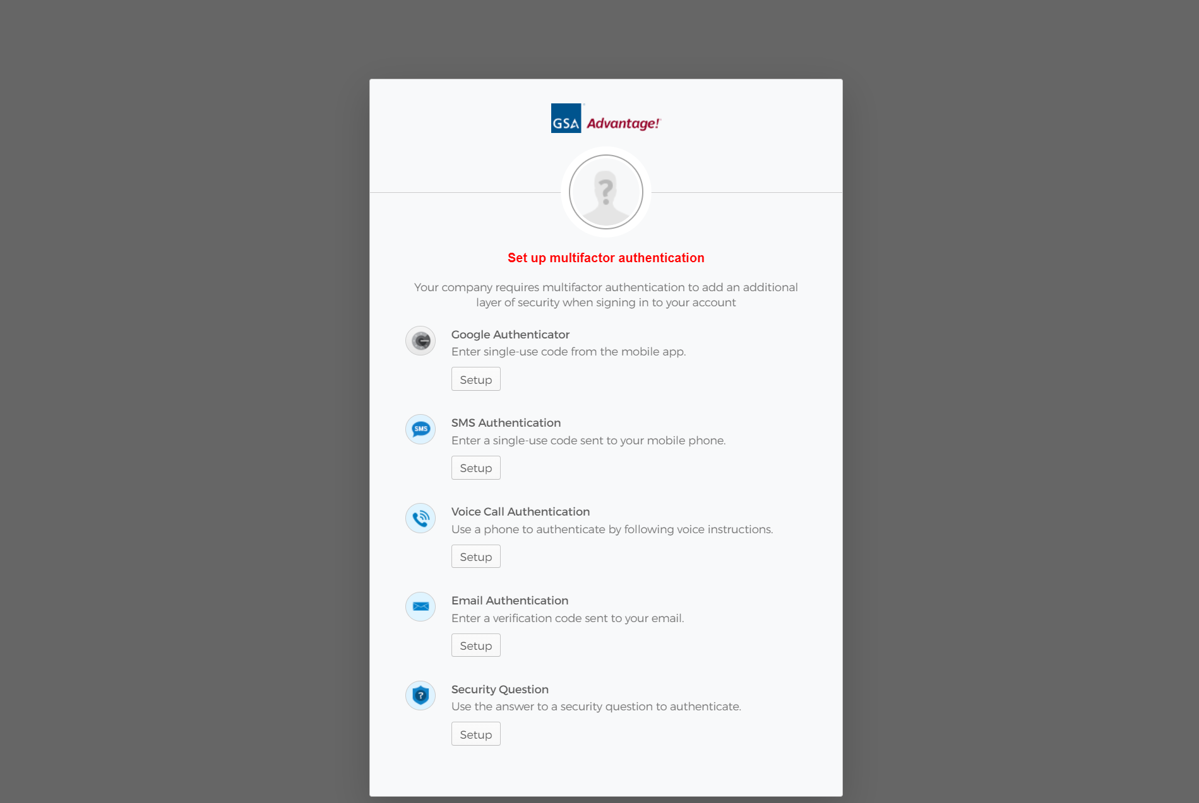
Multi-factor Authentication
Notes:
Now we will set up multi-factor authentication. We will choose two different methods; e-mail, and Google Authenticator. Choose “Google Authenticator” and click “setup”. You will be prompted whether you want the Android or iPhone versions.
You only get one chance to set these factors up, so make sure you see them through. If you ever need to add or update your multifactor options, you will need the Advantage helpdesk to reset your profile.
I STRONGLY recommend you set up at least two options for multi-factor authentication. At the moment, these cannot be updated later. You would have to have the helpdesk reset your methods, and set them up again. If one of your credentials (say, phone number) changed, having a secondary would mean you could still get into your account.

Slide 27
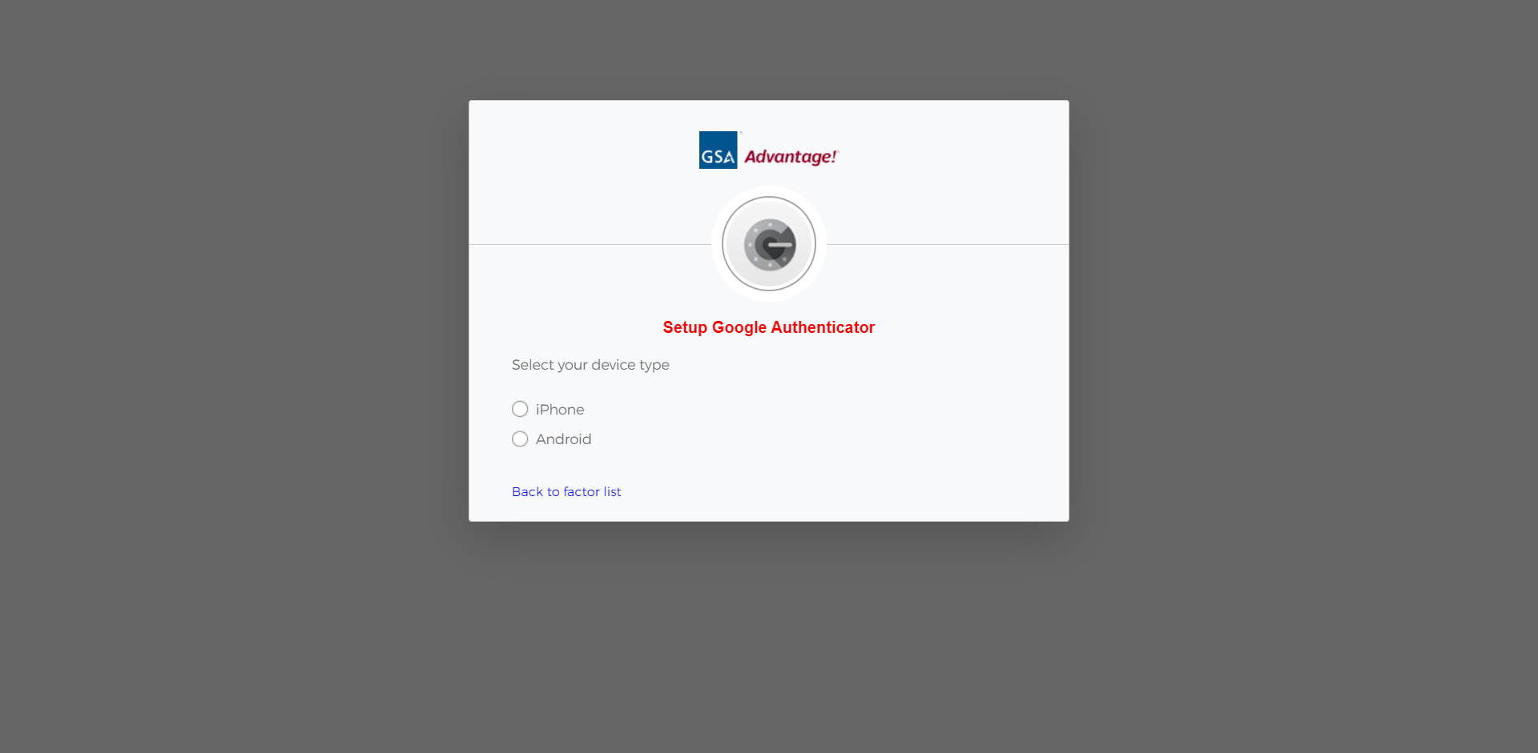
Multi-factor Authentication
Notes:
In this example, we’ll choose Android. You will need to download Google Authenticator app on your mobile device, and set it up.

Slide 28
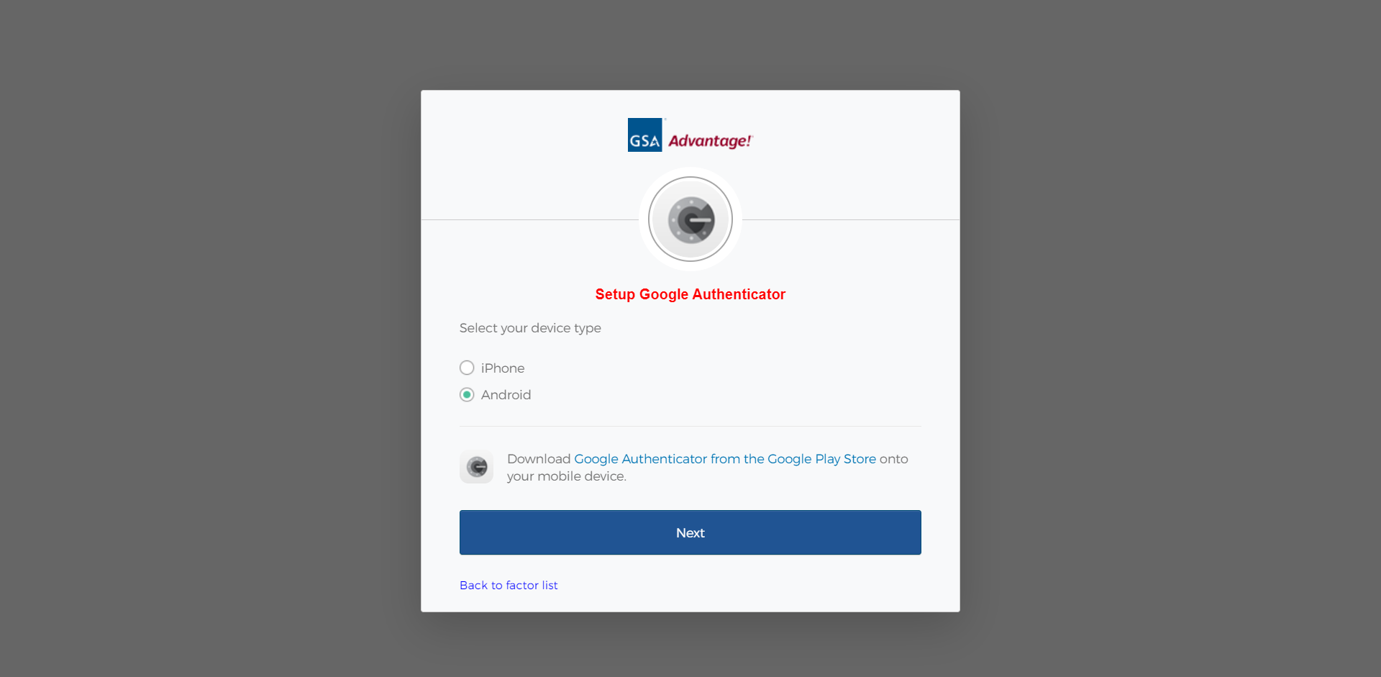
Multi-factor Authentication
Notes:
Click Next

Slide 29
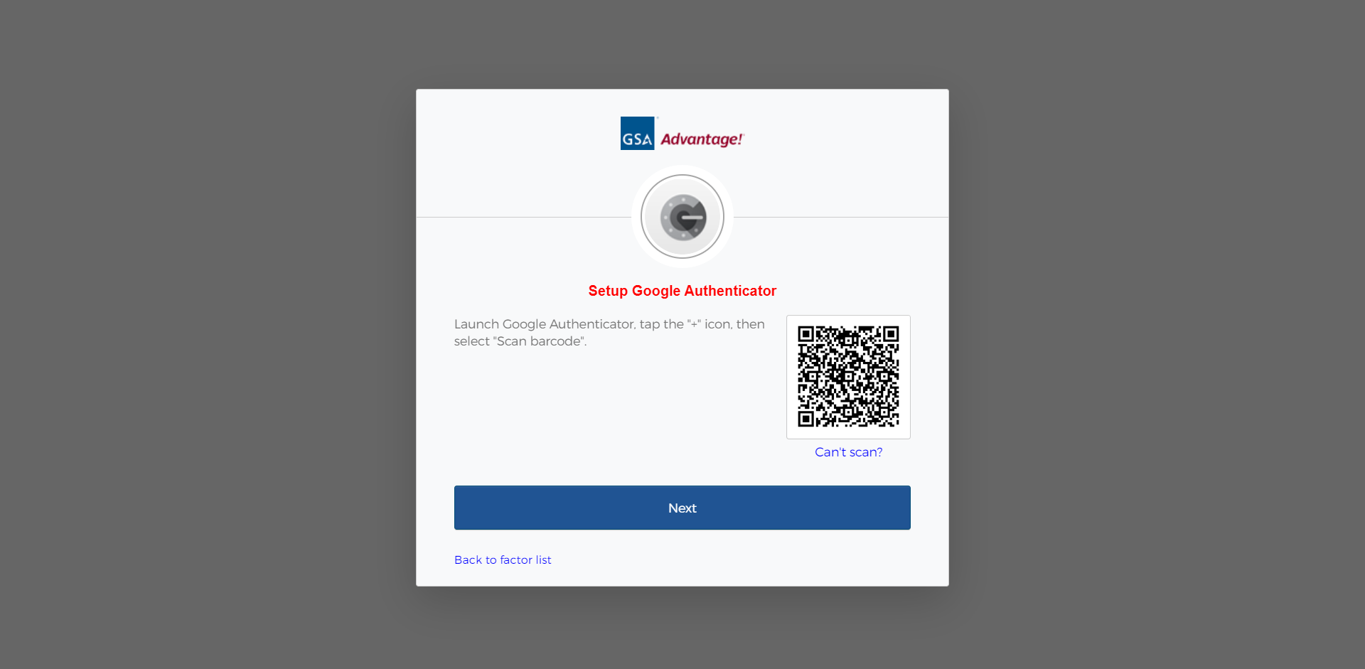
Multi-factor Authentication
Notes:
eBuy will display a QR code for you to scan.
Click “can’t scan”. Click Next.

Slide 30
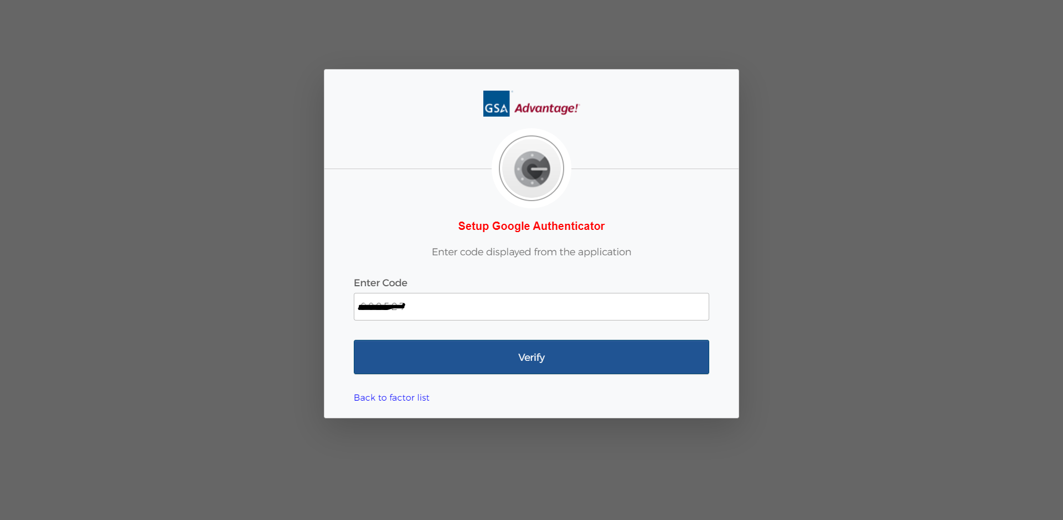
Multi-factor Authentication
Notes:
Enter the code provided by the Google Authenticator app on your mobile phone.
Click Verify.

Slide 31
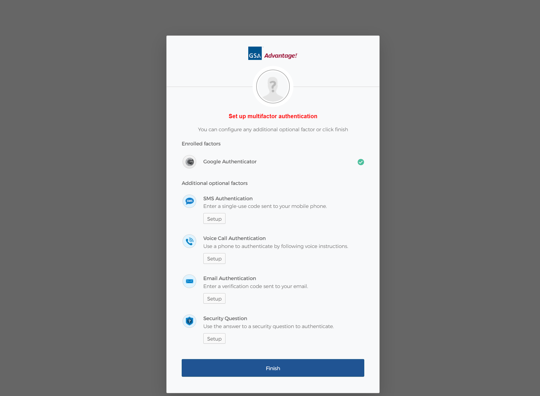
Multi-factor Authentication
Notes:
Click Setup for Email Authentication. This will be your secondary authentication method.

Slide 32
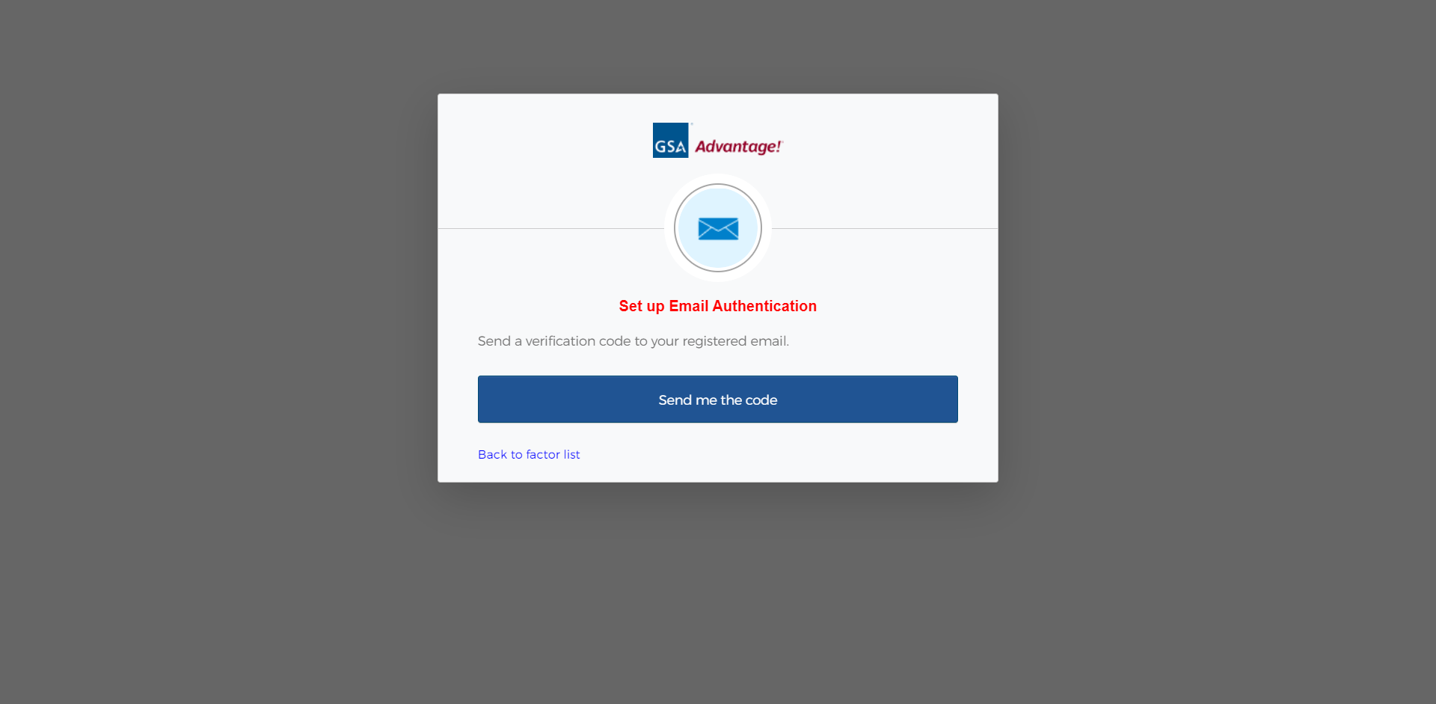
Multi-factor Authentication
Notes:
Click “Send me the code.”

Slide 33
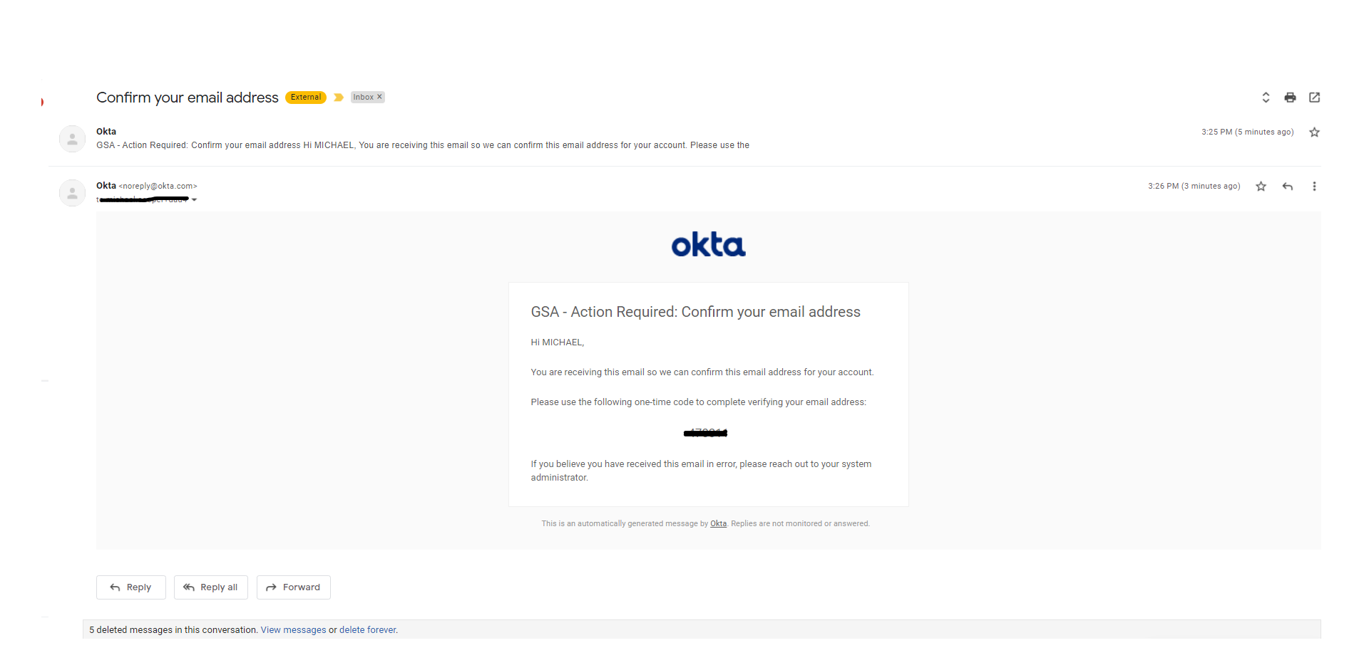
Multi-factor Authentication
Notes:
This is a sample of the email address verification message you will receive and have to enter the one-time code to confirm

Slide 34
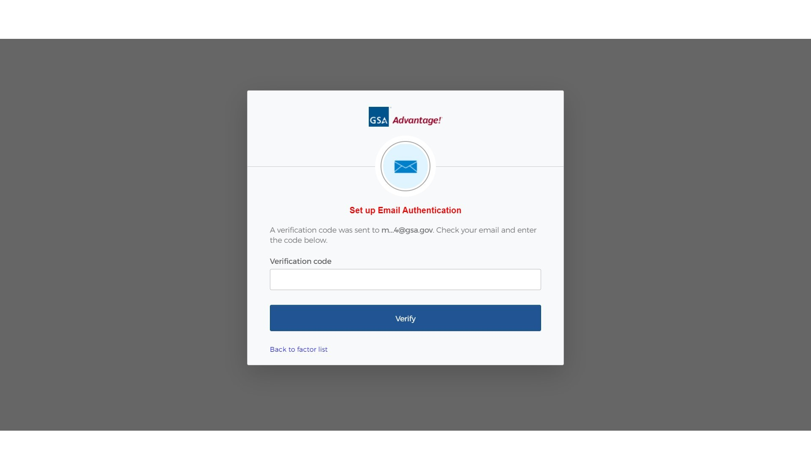
Multi-factor Authentication
Notes:
Enter the verification code

Slide 35
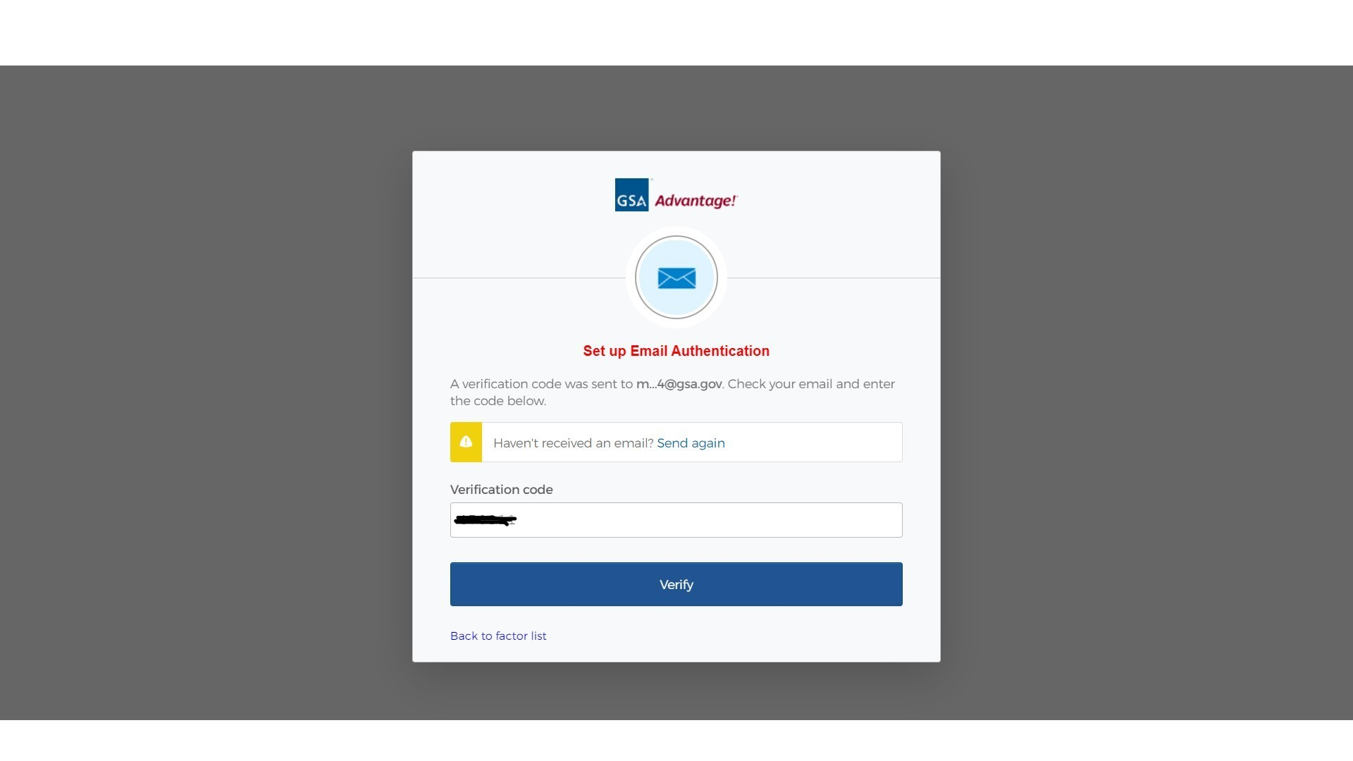
Multi-factor Authentication
Notes:
Click Verify

Slide 36

Multi-factor Authentication
Notes:
Click Finish. You have now set up multi-factor authentication.

Slide 37
Login
Notes:
Whichever method you use to log-ing and verify you will get to the eBuy Home page In the upper right corner, click Buyer.

Slide 38
Login
Notes:
Click Sign-in using PIV/CAC card

Slide 39
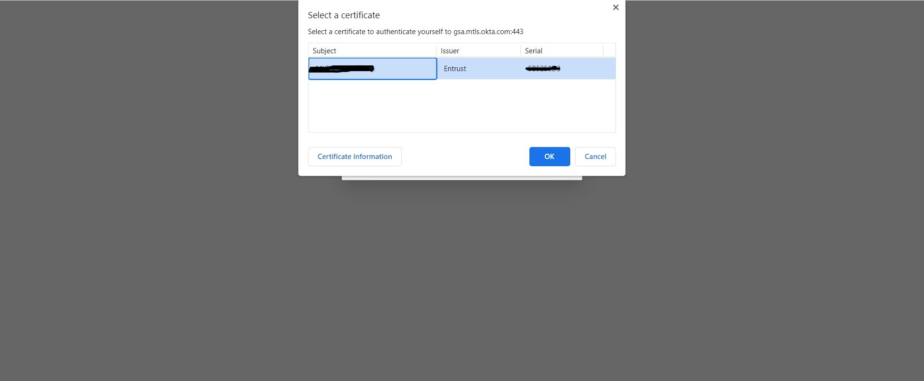
Login
Notes:
Select the correct certificate and click Ok.

Slide 40
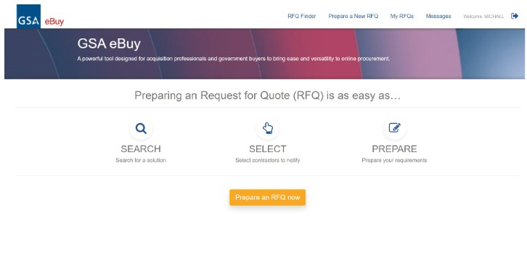
eBuy Buyer Homepage
Notes:
You are now at the Buyer Homepage.

Slide 41
Prepare an RFQ: Overview of the Process
Notes:
The general process for creating an RFQ is to Search to find the solution for posting your requirement, Select the contractors who will be notified, Prepare the RFQ by including information in the RFQ and finally review & submit your RFQ.
A few points about the menu options on this page.
The RFQ finder is a quick way to open up an RFQ that you’ve created. It also allows you to retrieve an RFQ that has been forwarded to you from another eBuy user.
Prepare a New RFQ, or the button in the middle of the screen will start the process for creating an RFQ.
My RFQs provide access to Active or Archived RFQs.
Messages are notifications related RFQ activity
Clicking your name will provide information about your account
For an example of how to create an RFQ, we will create one for outfitting a conference room. Let’s click Prepare an RFQ now.

Slide 42
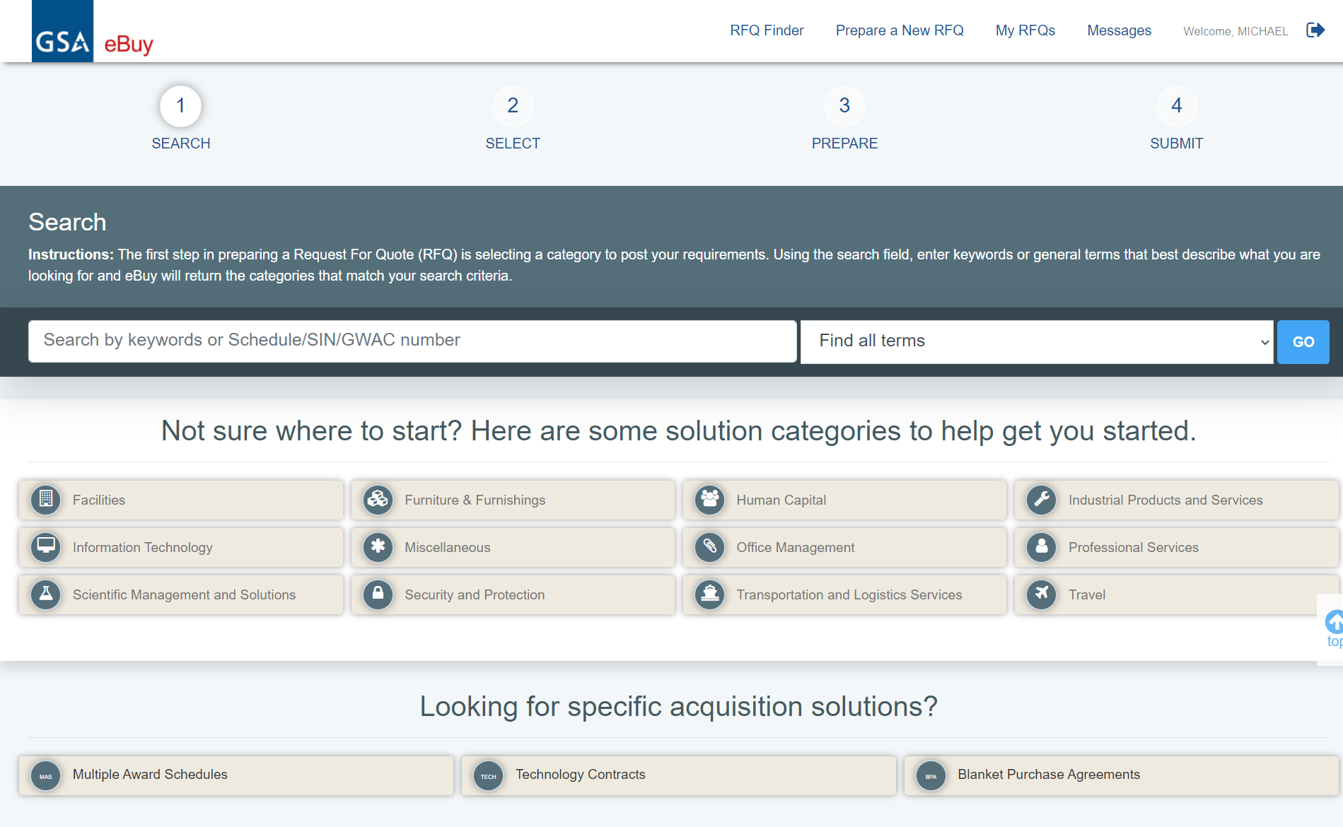
Prepare an RFQ: Looking for a Category to post RFQ
Notes:
As you work your way through preparing your RFQ there are four major steps. They are Search, Select, Prepare and Submit. You will learn about each of the four steps as you progress in this training. Our example will be outfitting a conference room.
Notice the solution categories to help you get started.
There are 12 Large categories. Under the large categories are three specific acquisition solutions.
The first step in the RFQ process is to search for solutions/sources, and eBuy has several ways you can accomplish that search. You can just do a keyword search. Keywords search against the titles and descriptions of large categories, and other vehicles. Another option is to browse by category. We have grouped solutions into some main categories, and browsing will let users navigate from general to specific.
The following are examples of browsing by category. The first example is browsing by Multiple Award Schedule.

Slide 43
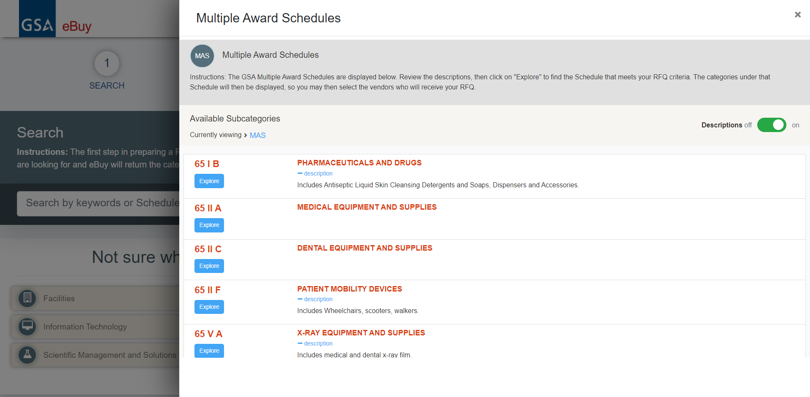
Prepare an RFQ: Looking for a Category to post RFQ
Notes:
To browse by Multiple Award Schedule.
Clicking on the MAS list will show all of the MAS schedules in a modal. The ones shown here are the VA Medical schedules but you can scroll down to the GSA MAS schedule with all the subcategories. This might be the quickest way to navigate there.
The next example is browsing by technology contracts

Slide 44
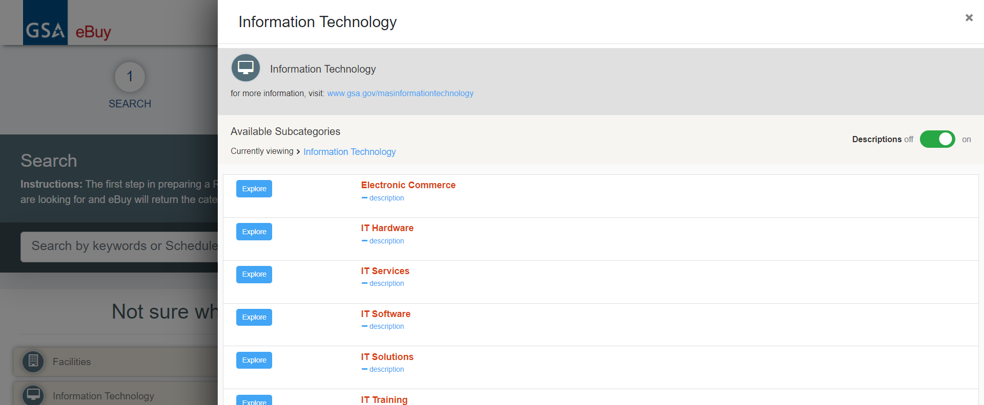
Prepare an RFQ: Looking for a Category to post RFQ
Notes:
A modal will pop up with the available subcategories.

Slide 45
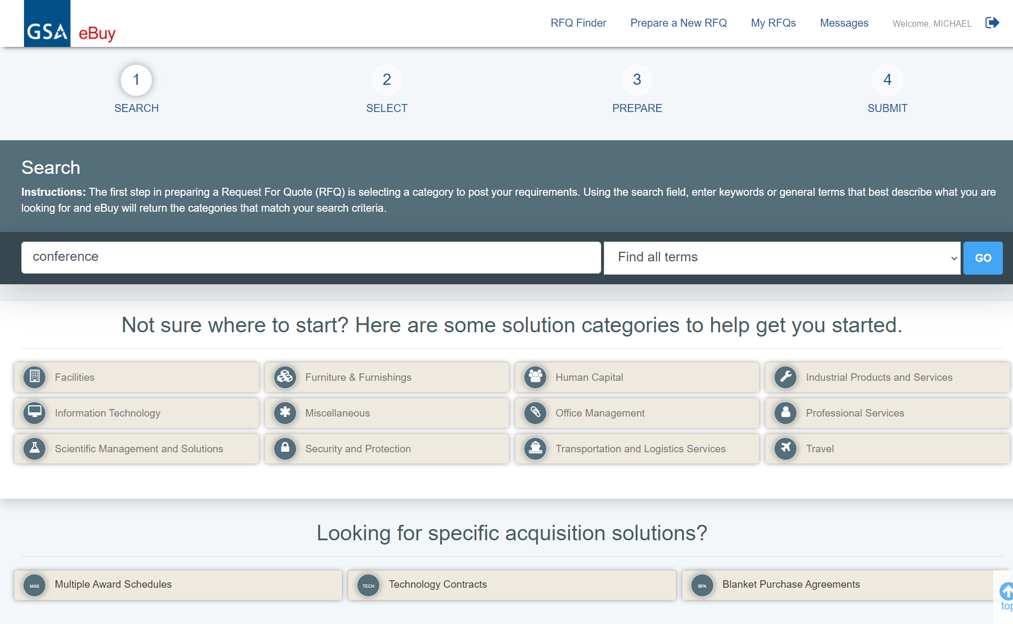
Prepare an RFQ: Looking for a Category to post RFQ
Notes:
We’re going to use the keyword search function. We’ll do a search for “conference”, click “go”, and see what comes up. You can toggle the search to look for all of the terms, any of the terms, or the exact phrase.

Slide 46
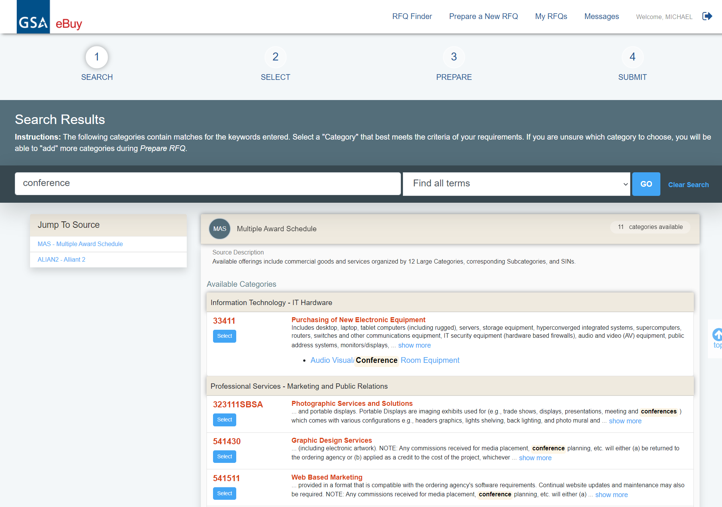
Prepare an RFQ: Search Results
Notes:
Here we are at the search results. eBuy searches all of the titles and descriptions of different categories or vehicles, and returns them for you. You can use the “jump to source” box on the left side to jump straight to any one of the vehicles identified. In this case we have a mixture of schedules and technology contracts. Under 33411 click on Select to select this SIN.

Slide 47
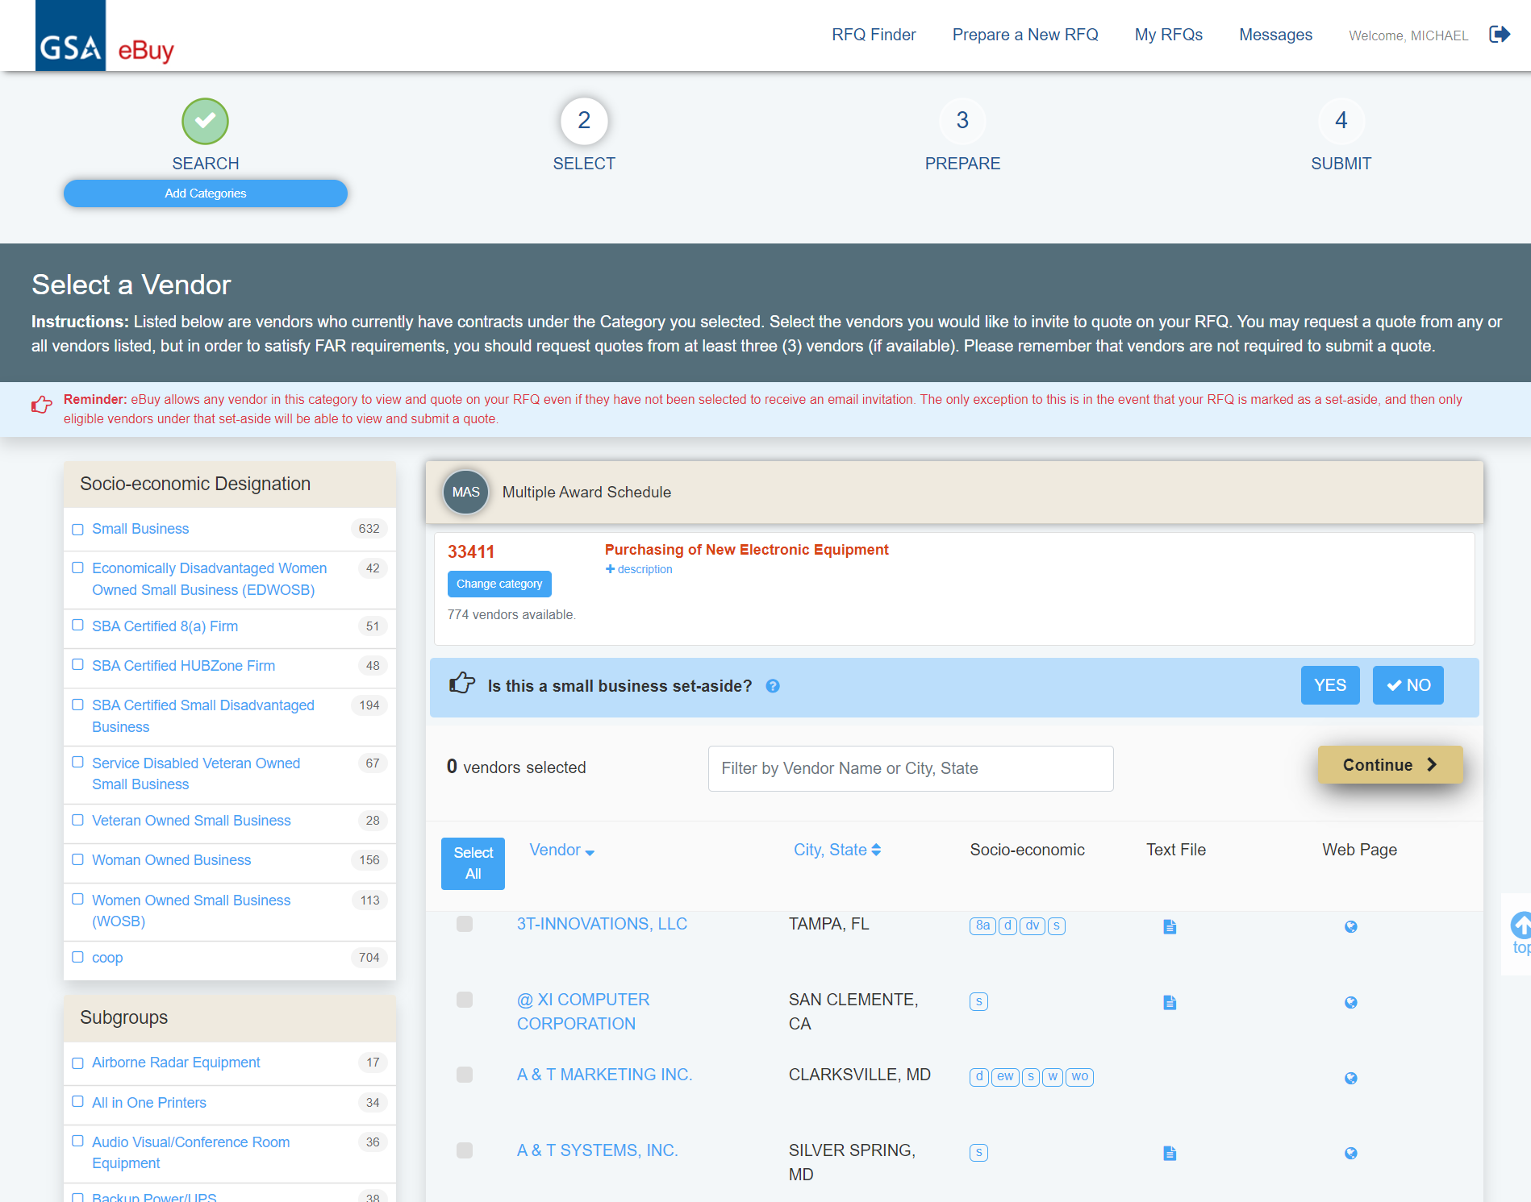
Prepare an RFQ: Search Results
Notes:
Here a list of 774 companies are displayed. You can toggle the small business set-aside option on or off if your need requires that you limit competition to only qualifying small businesses. Also, if you want to see more information about a vendor, click on the hyperlinked vendor name. The next slide is an example of what information is available if you click on the hyperlinked vendor name of BLUE TECH INC.
This screen is also a prime example of how much can be done in place. We have a lot of functionality here to make it very easy to identify sources. All of the filters toggle the list in place, without reloading the screen. You can view the SIN description by clicking the plus button to the left of description, or change out the category. You can select a Subgroup to further refine the list of contractors based on your criteria. You can also select socio-economic types to filter the list even further. Each type you select will add on to the previous, allowing you to toggle them independently. You can toggle socio economic status on or off, or you can do a small business set-aside.

Slide 48
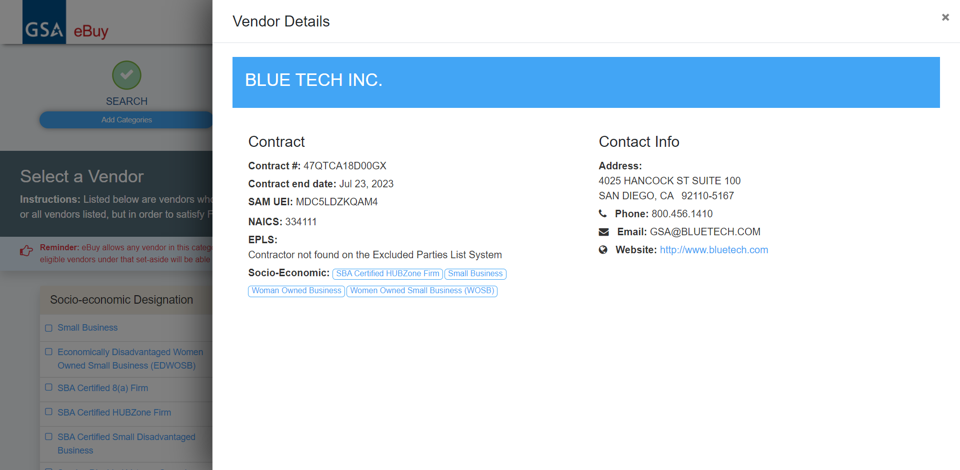
Prepare an RFQ: Select A Vendor
Notes:
Contractor details come up in a modal. You can see the contract number, NAICS, socio-economic information, and more. Click the X to close this screen.

Slide 49
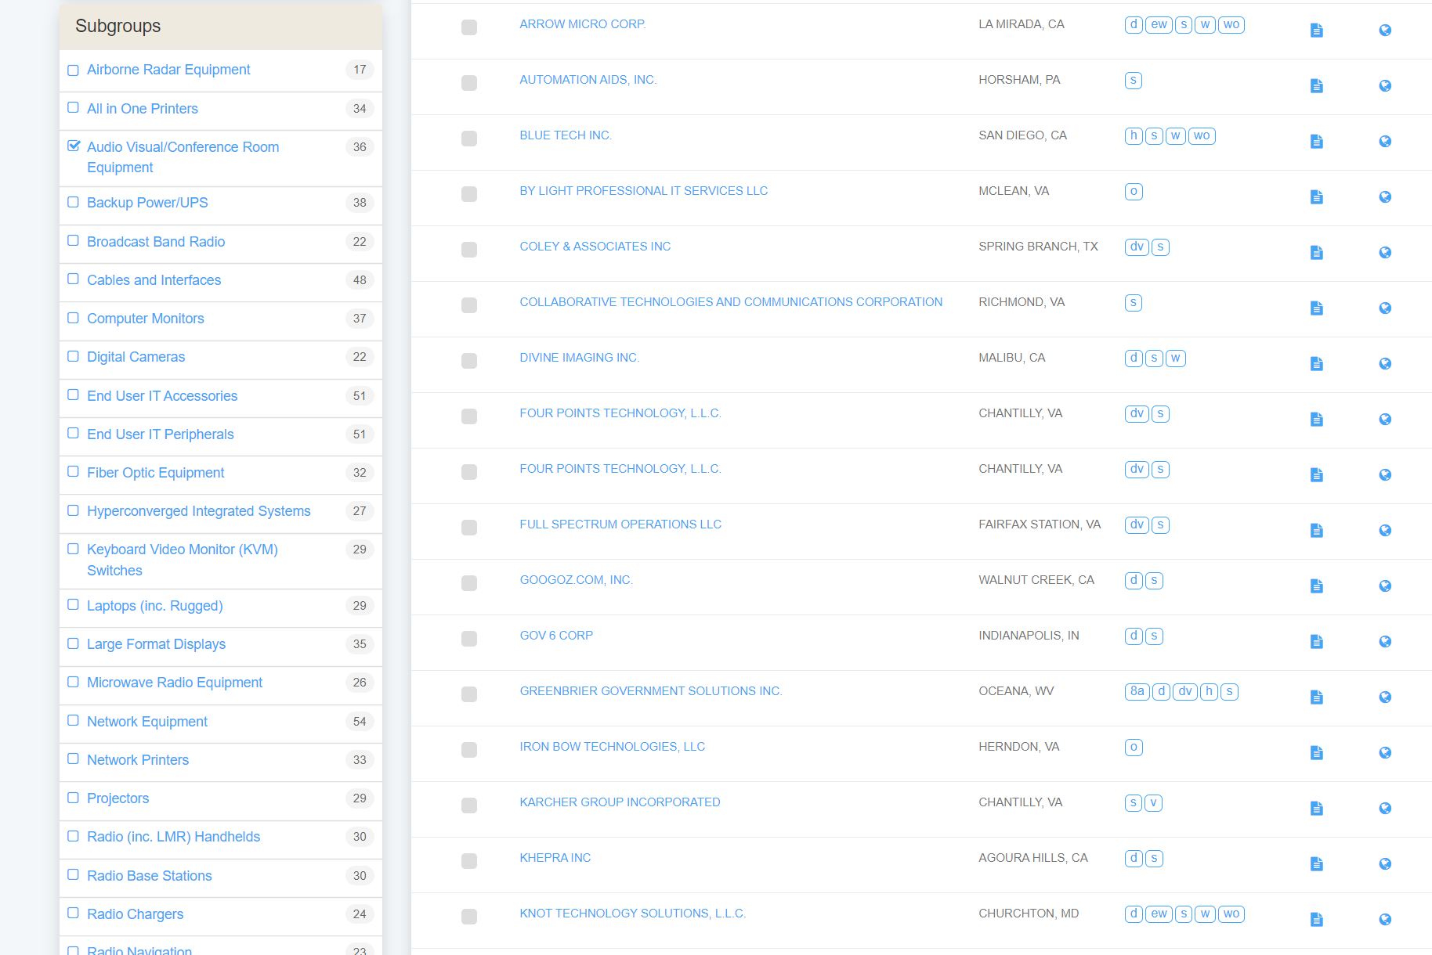
Prepare an RFQ: Select A Vendor
Notes:
Now that we are back at the list of contracts we see the Subgroups listed to the right along with the number of contractors in those subgroups to help you further refine your search.

Slide 50
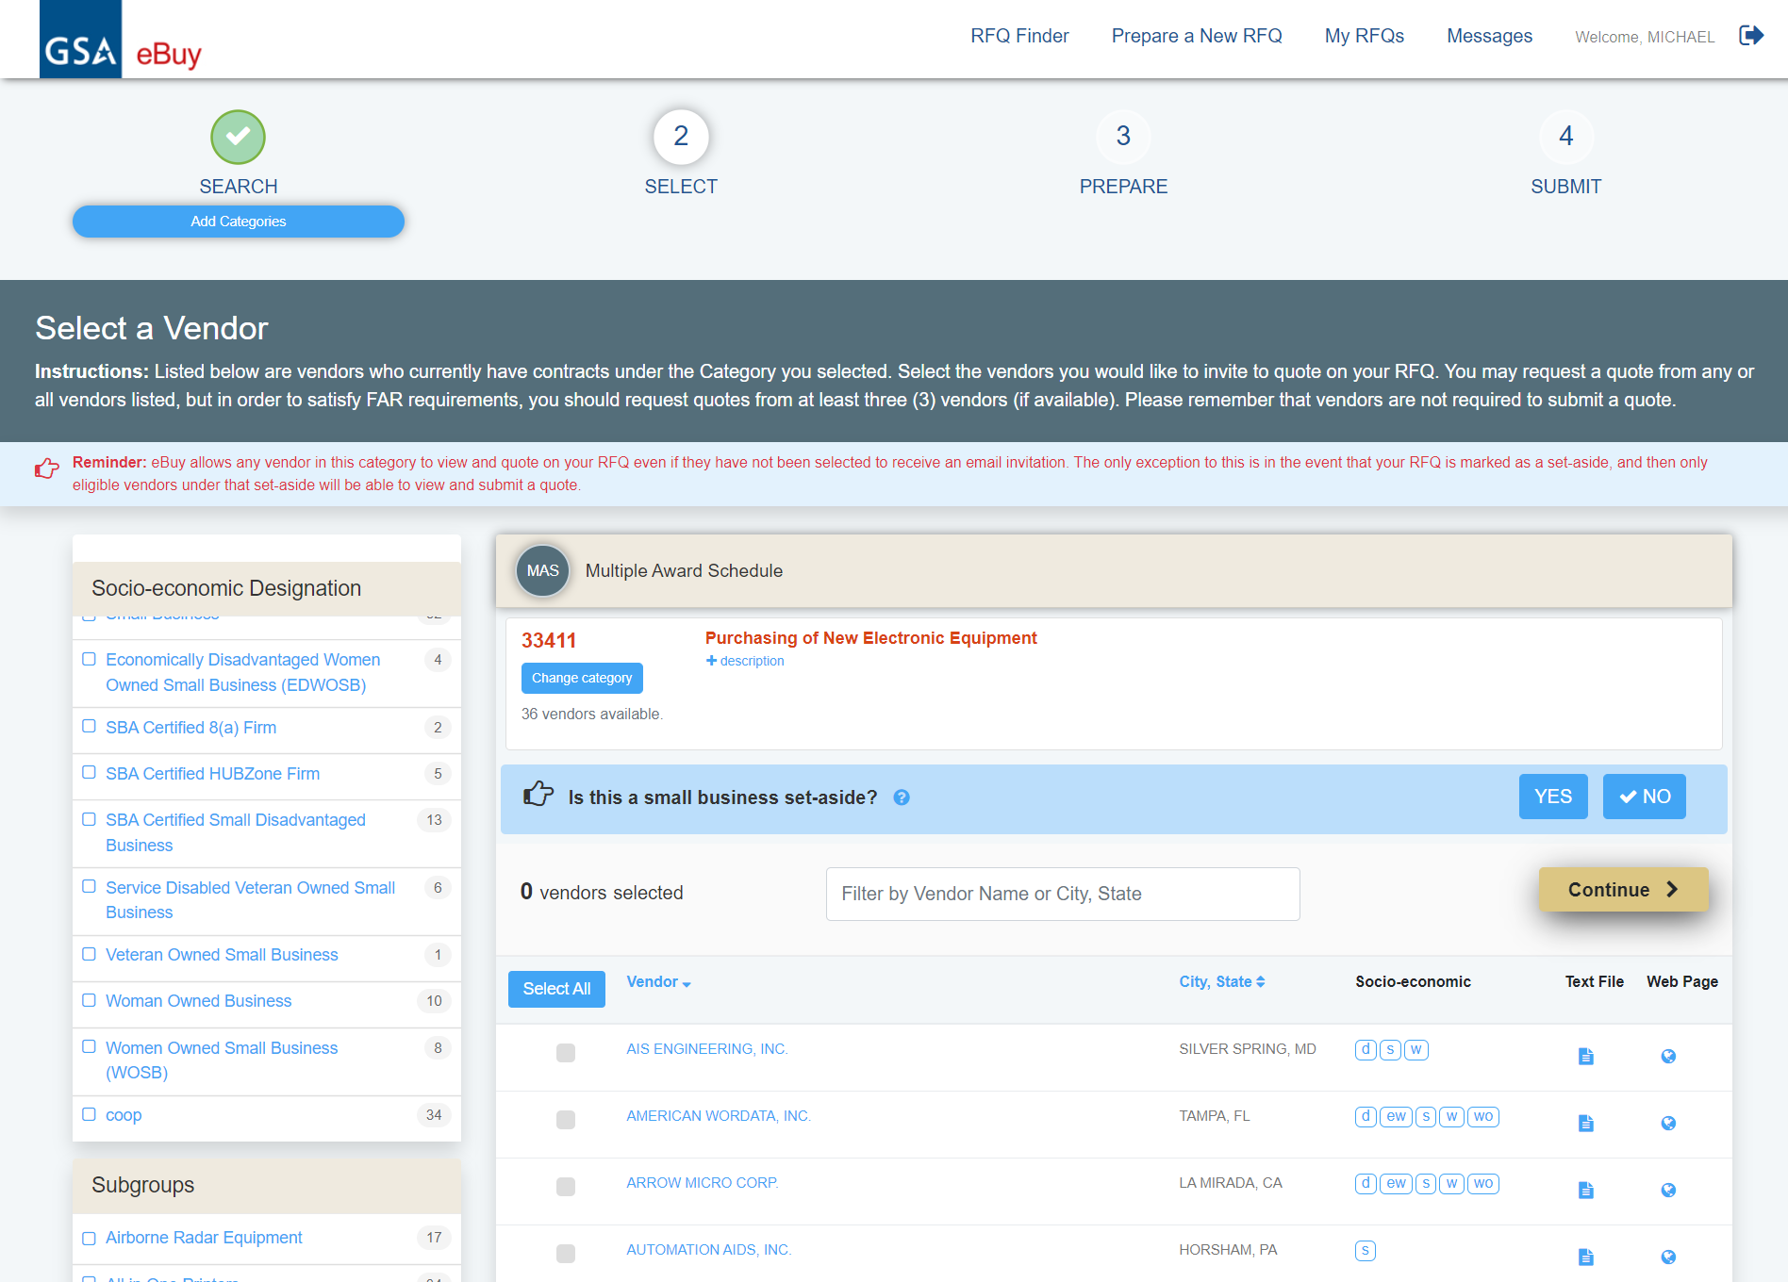
Prepare an RFQ: Select A Vendor
Notes:
If you want to get the definition of the different socio-economic indicators, click on one of the icons and a dialog box with the definitions will display.
Under the ‘Socio-economic’ column click on one of the three socio-economic indicators to the right of SILVER SPRING, MD.

Slide 51
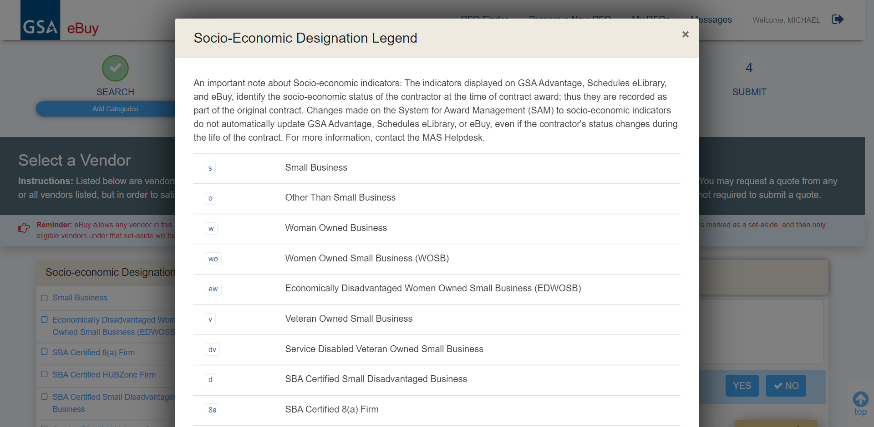
Prepare an RFQ: Select A Vendor
Notes:
After clicking any of the three socio-economic indicators to the right of SILVER SPRING, MD you will get a list of icons and their definitions.

Slide 52
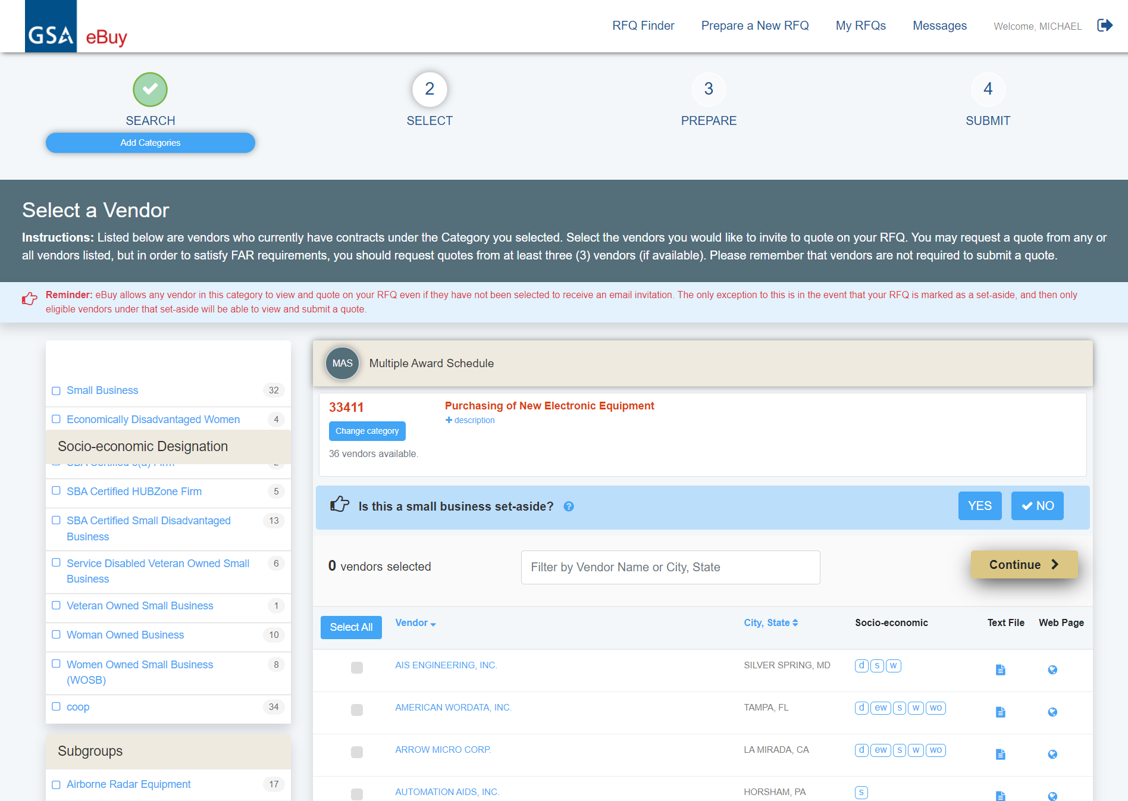
Prepare an RFQ: Select A Vendor
Notes:
Let’s look at the small business set-aside for a moment. You have the ability to toggle this functionality on and off. If you click it, a submenu will open allowing you to select the set-aside type.

Slide 53
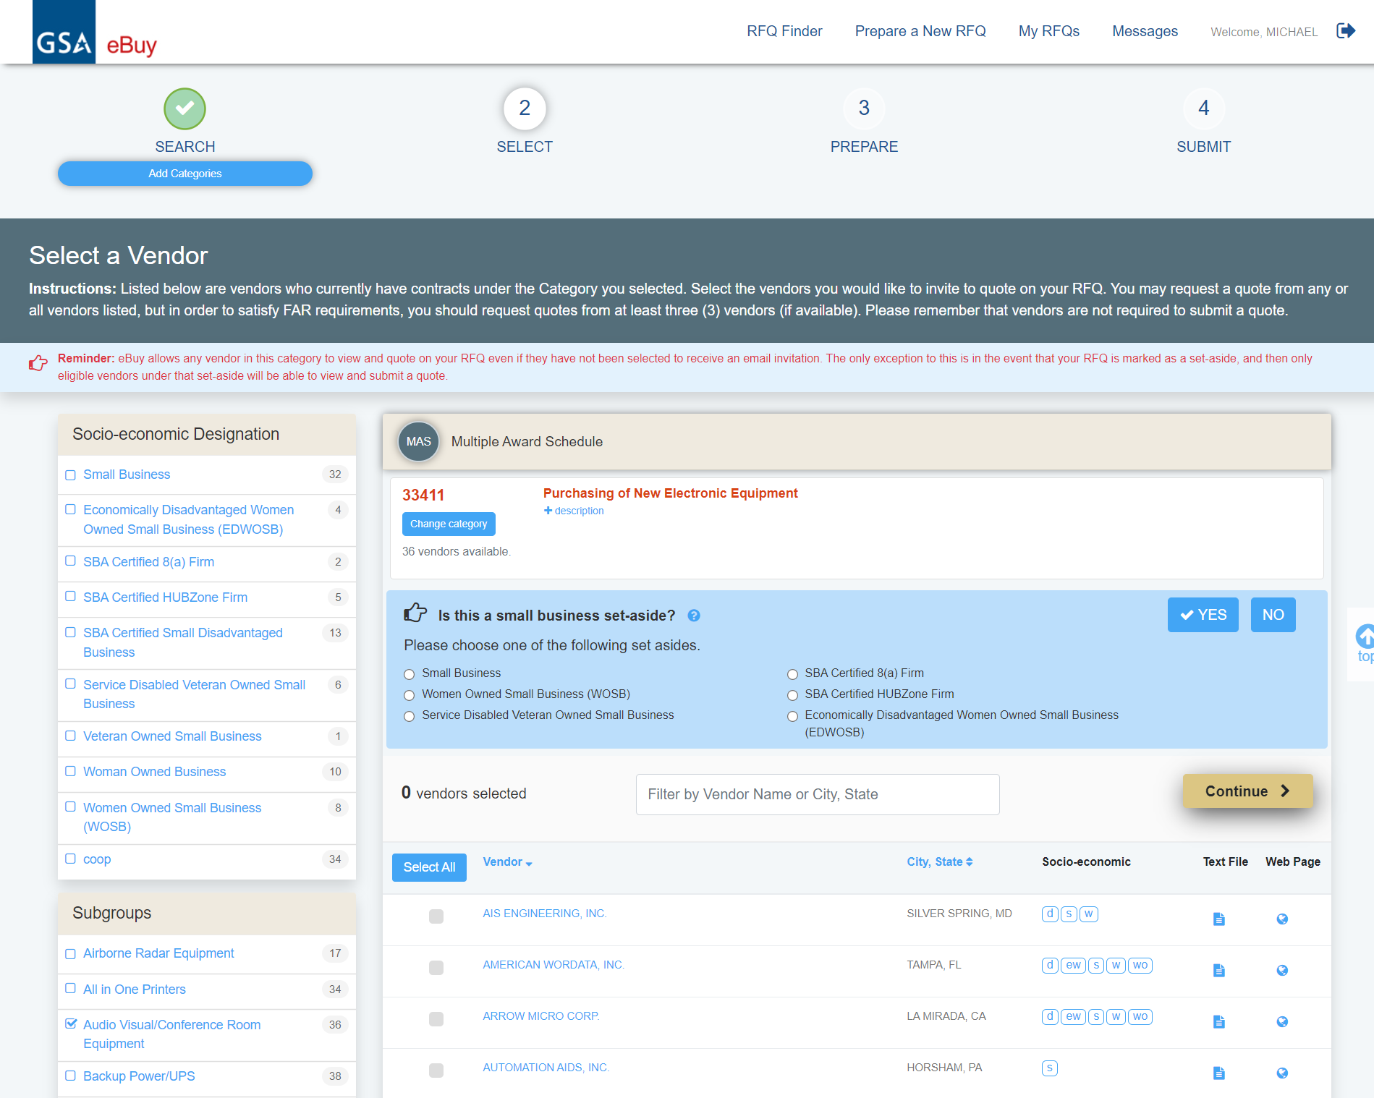
Prepare an RFQ: Select A Vendor
Notes:
Unlike filters, set-asides can only be set for ONE designation, so use this in tandem with the toggle at the left to see which vendors meet which designations. Once you make a choice, the RFQ will only be visible to vendors who meet the designation.

Slide 54
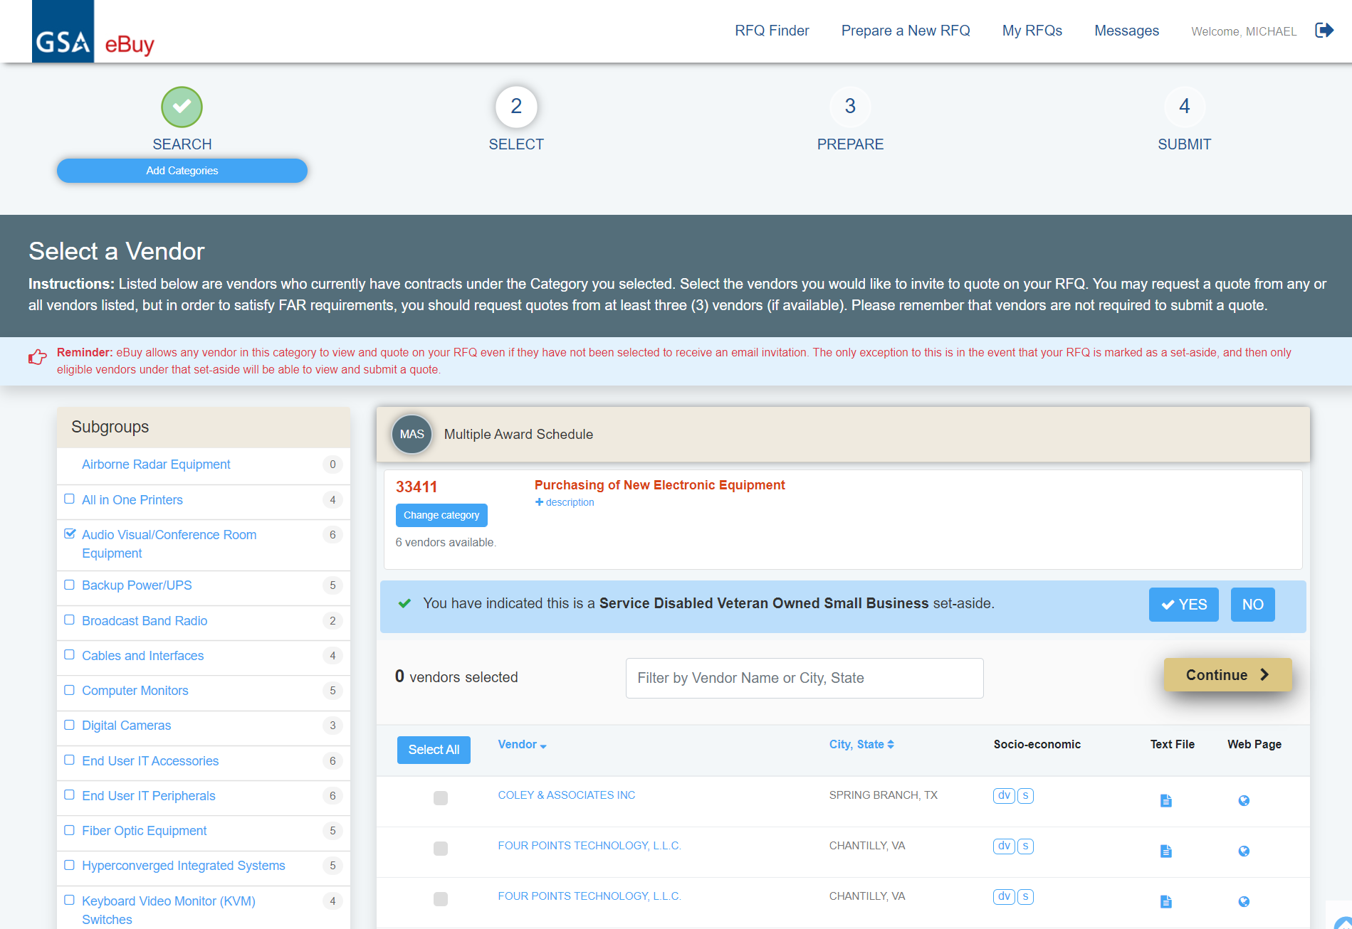
Prepare an RFQ: Select A Vendor
Notes:
But here is what it would look like if we chose “SDVOSB”.

Slide 55
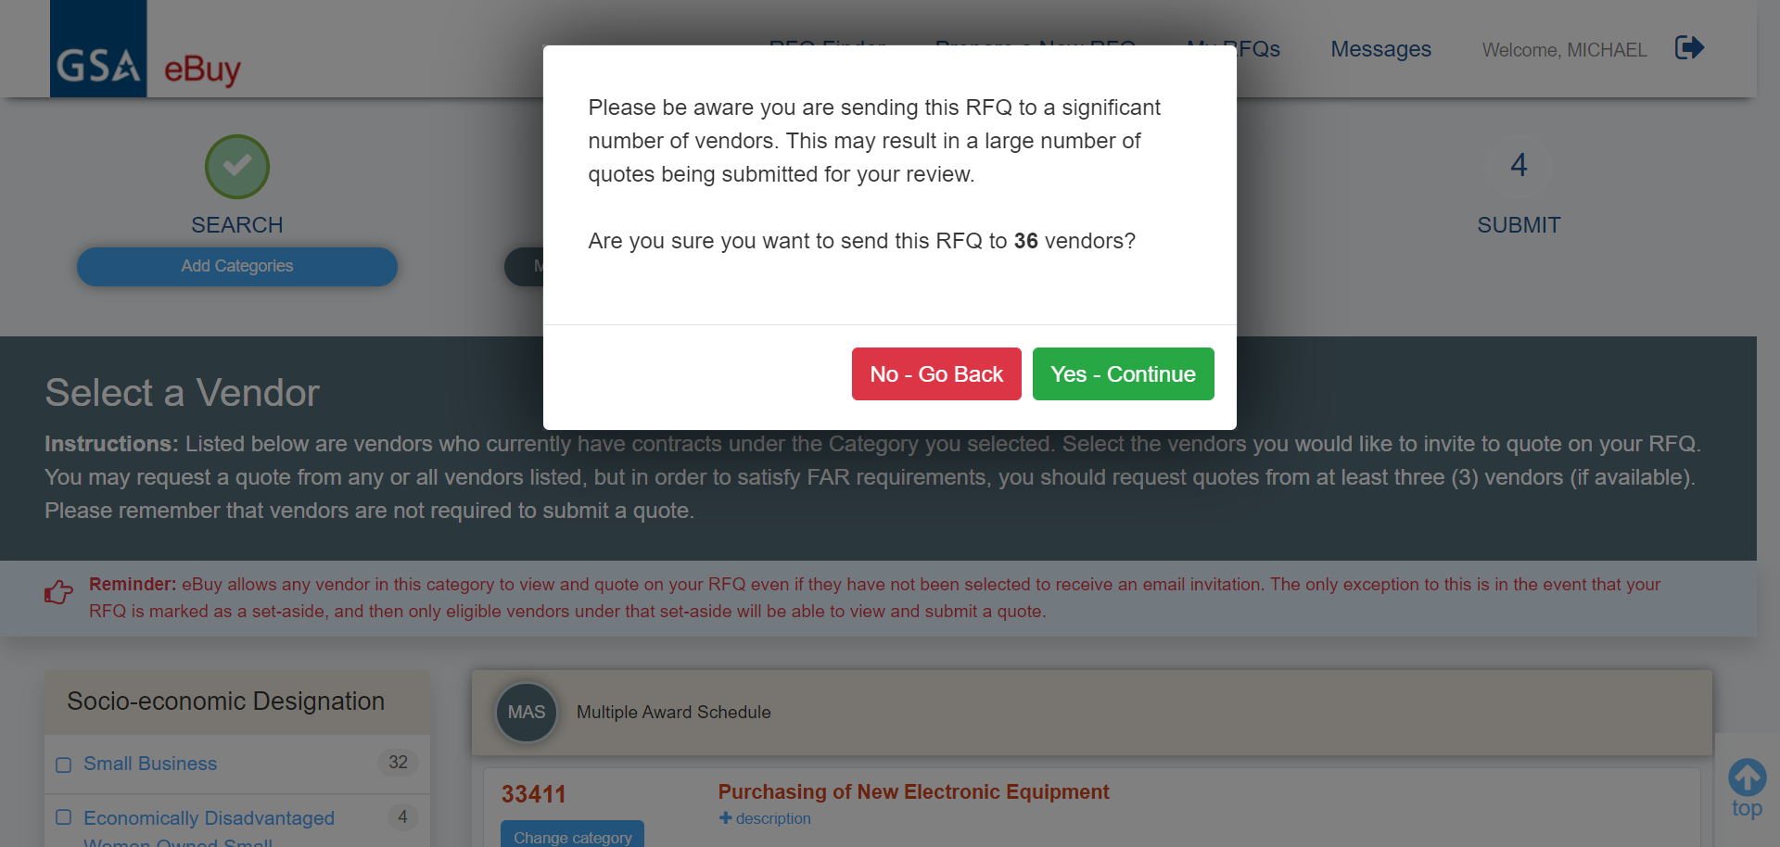
Prepare an RFQ: Select A Vendor
Notes:
Notice the message to verify if you want to send the RFQ to the number of vendors you’ve selected. Click Yes.

Slide 56
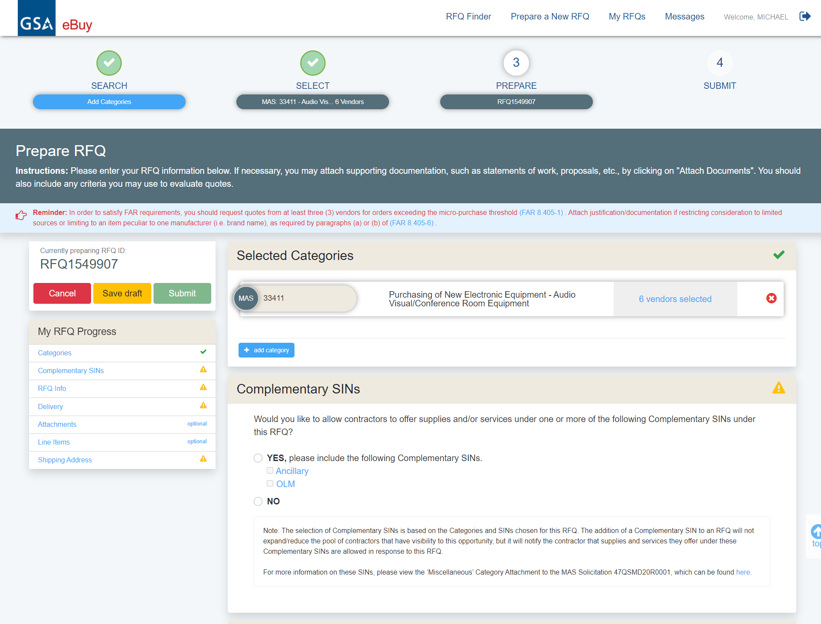
Prepare an RFQ: Select A Vendor
Notes:
After selecting our vendors, we arrive at the main prepare RFQ screen. Now if you want to add additional vendors from another category, you would click the “add category” button, and go back through the selection process.

Slide 57
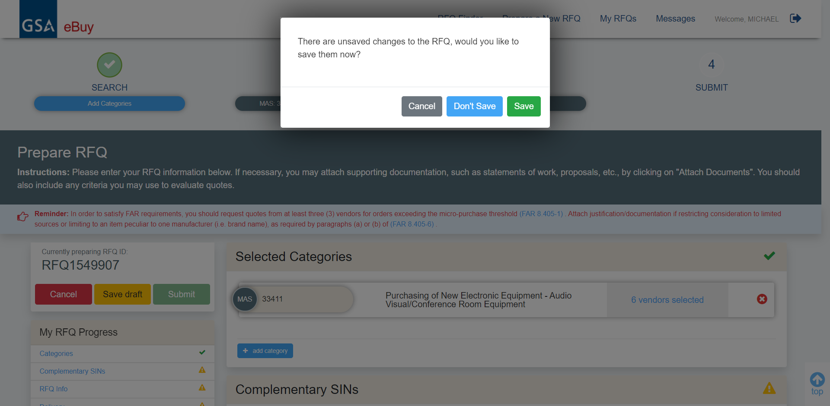
Prepare an RFQ: Select A Vendor
Notes:
Click Save to save the RFQ.

Slide 58
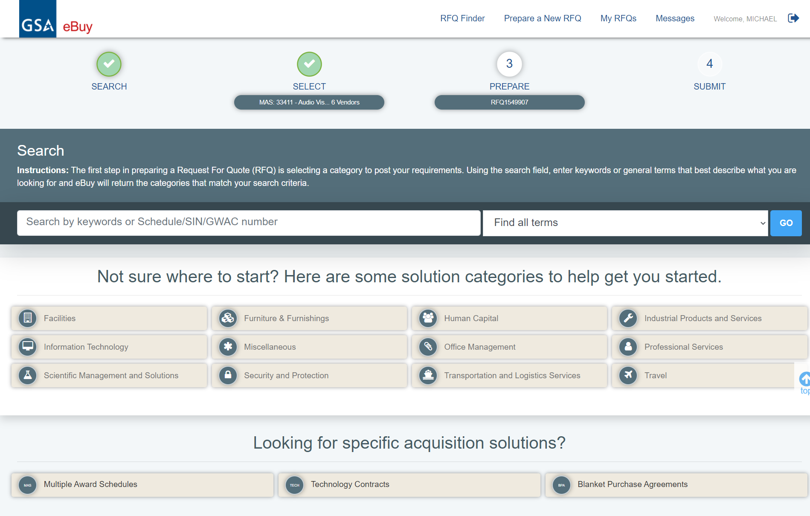
Prepare an RFQ Screen
Notes:
For our example for building a conference room we need to add a second category of sources to the RFQ.
We will look under the “Furniture and Furnishings” category.

Slide 59
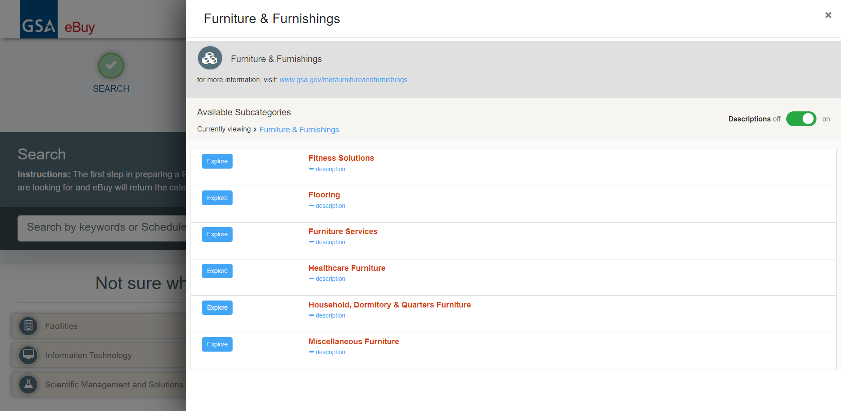
Prepare an RFQ Screen
Notes:
Browsing deeper into the category, we have “furniture services”. Let’s click it.

Slide 60
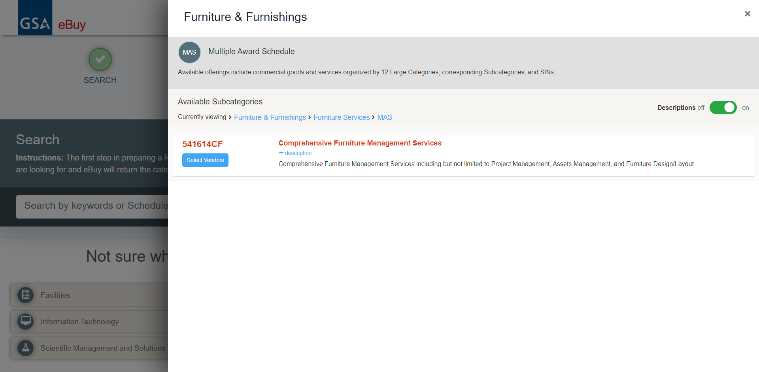
Prepare an RFQ Screen
Notes:
We’re looking for design services. Reading the description, it appears that this subcategory would contain those offerings.

Slide 61
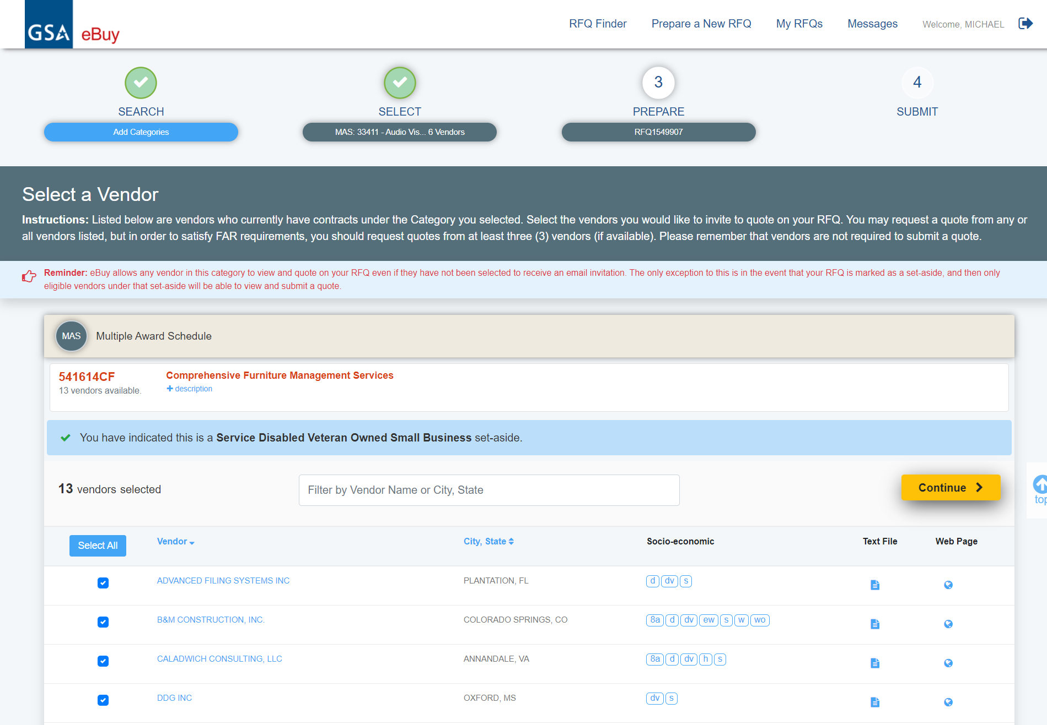
Prepare an RFQ Screen
Notes:
Here is the list of vendors. Just like before, we will hit “select all” and then click continue.

Slide 62
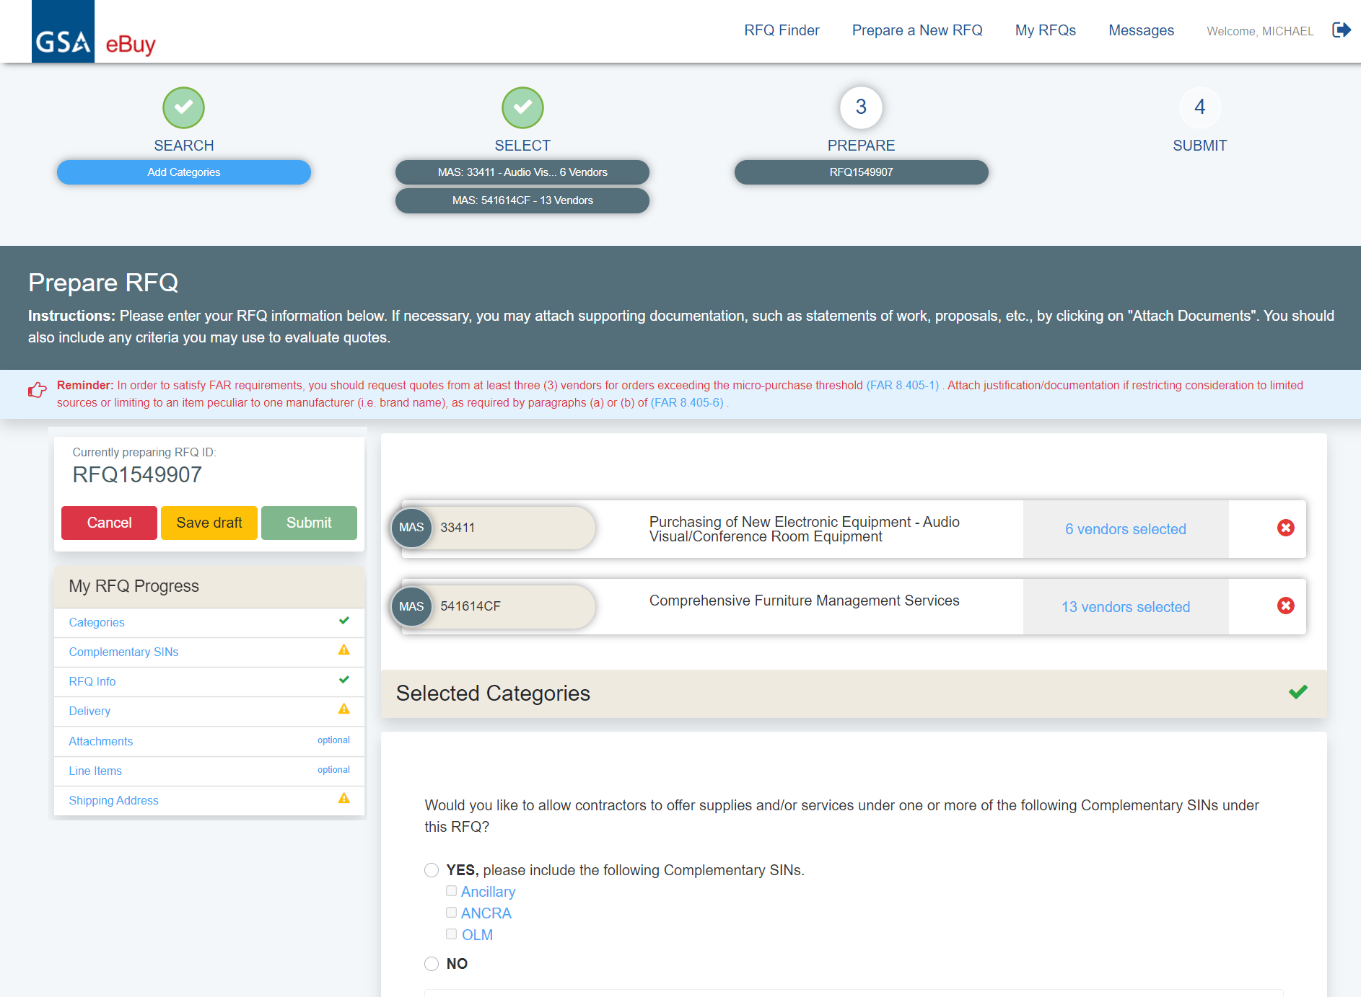
Prepare an RFQ Screen
Notes:
You may notice that the navigation trail up here is growing. Each of those buttons lets you revisit the parts of the RFQ that you configured before. This interface is much more powerful and lets you make changes to anything you set up before. You can pretty much jump to any section of the RFQ process.
Also, notice the left side navigation where it indicates My RFQ Progress. It has links that will allow you to jump to any part of the RFQ. It also shows which items are completed, which require action and which ones are optional.

Slide 63
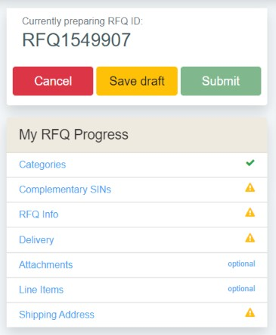
Prepare an RFQ Screen
Notes:
Here, is a zoomed in view of that progress navigation table. You can see each section and what is required. We will cover each section one at a time.

Slide 64


Prepare an RFQ Screen
Notes:
We’ll start with the “complementary SINs” section. This is where you can add whether or not you want to add:
Ancillary: Ancillary supplies and/or services are support supplies and/or services which are not within the scope of any other SIN on this schedule.
Ancillary repair and alterations (ANCRA): Includes ancillary repair and alteration services ordered in conjunction with the delivery, or installation of products or services.
Order Level Materials (OLMs): OLMs are supplies and/or services acquired in direct support of an individual task or delivery order placed against a Schedule contract or BPA.
We’ll select them all in this example.

Slide 65

Prepare an RFQ: RFQ Info Section
Notes:
Now we’ll move onto the RFQ info section, where we put in the basic details about the request.
We’ll start with the RFQ title. You want to give your RFQ a clear and descriptive title. Vendors may look through a large number of RFQs at any given time. A descriptive title makes it easier for vendors to understand what it is you are looking for quotes on.
The reference number field is optional, and can be used for an internal control number you may have (or anything else you might need).
The description field is probably the most important aspect of eBuy. Use it to emphasize any critical points that you want to make sure are clear. Some folks will emphasize evaluation criteria, or will reiterate critical requirements. Some will use it to describe the request in its entirety.
The default close time is 5 calendar days from RFQ creation, and the absolute minimum is 48 hours. Please give consideration to the complexity of your RFQ when you are setting the close time. If you are just looking for volume discounts off a standard price, then a week might be long enough for vendors to quote. If you are doing something much more complex, then you will want to give vendors more time.

Slide 66

Prepare an RFQ: RFQ Info Section
Notes:
Here are the RFQ info fields, all filled out.
Note that “Seeking Sources or Information only” is not selected because we are submitting an Request for Quote (RFQ), and not performing market research.
The ‘Seeking Sources or information only’ checkbox is an optional field that is also commonly referred to as
Request for Information (RFI). By selecting this box, you are informing contractors that your RFQ is for
information only or you are only conducting market research. Please note that eBuy instructs contractors that
they should not quote on RFQs that are for seeking sources.
Why use Seeking Sources? Seeking sources (or RFIs) are a helpful market research tool that can help answer
many questions:
Are my requirements clear?
Which categories or solutions best meet my needs?
Are there contractors that can perform my requirement?
Are there contractors interested in performing my requirement?

Slide 67

Prepare an RFQ: Delivery Options
Notes:
Next, we will consider options for delivery time. There are three options.
The 1st is to request delivery a specific number of days after the order has been received. This is suited for products.
2nd is Date of award to date of completion - for when you do not have specific start and end dates.
3rd - Period of performance is for when you have a very specific begin and end date. Say you are looking to get security services for a fiscal year. You would know the exact begin and end date for the service.

Slide 68

Prepare an RFQ: Attaching Documents
Notes:
Now we’ll move on to the “Attach Documents” section. This section is optional, but very useful. You can click on the “Drag files here or Choose” area to bring up a dialogue box, or you can drag files from a file explorer or desktop straight into the area. Each file can be up to 100 MB in size.
You might upload spreadsheets of parts, or blueprints, schematics, designs, or anything that is relevant to your RFQ. The upload interface has been modernized thanks to all of the comments received from customers.

Slide 69

Prepare an RFQ: Attaching Documents
Notes:
We’ll click the upload area, and bring up the dialogue box. Select what you want to upload, and click “open”.

Slide 70

Prepare an RFQ: Attaching Documents
Notes:
Uploaded files will appear to the right of the interface.
There is a set of instructions at the top of the interface regarding special characters and upload sizes. Now we’ll move on to line items.

Slide 71
Prepare an RFQ: Line Items
Notes:
If specific products are being requested on the RFQ, space is provided to enter Line Items or upload a spreadsheet containing a list of line items.
Line items are optional, but can be very useful in situations like our example. Vendors who offer the products will be able to quote directly on the line item. We will fill this section out to show how it works. Shipping addresses can be loaded from your profile. If you only recently registered, now is a good time to start putting in addresses.

Slide 72

Note About GSA Advantage
Notes:
A quick note.
You can also use GSA Advantage to do some research on some of the items I might want. In this example, I can look for phones, screens, chairs, and more…

Slide 73

Prepare an RFQ: Line Items
Notes:
When just a few line items are being identified on the RFQ, we suggest using the “Add Line Item” feature and enter the line items one at a time. But if you have a lot of line items you have the option to use an Excel template to upload them. Wel’ll look at each option. First if we Click Add Line Item.

Slide 74

Prepare an RFQ: Line Items
Notes:
Enter the needed line items.
Click “Add line items to RFQ”

Slide 75


Prepare an RFQ: Line Items
Downloaded spreadsheet template:
Notes:
If your RFQ will include many line items, eBuy offers a Bulk line item upload to assist in adding line items to the RFQ from a spreadsheet
From the pop-up window, download the spreadsheet template. This spreadsheet contains instructions and the columns/fields necessary to upload to the RFQ.

Slide 76

Prepare an RFQ: Line Items
Notes:
This is how the template looks after opening it.

Slide 77

Prepare an RFQ: Line Items
Notes:
Review and follow the notes as you enter your line items. Enter the mandatory line item fields into the spreadsheet. Upload the spreadsheet using the drag and drop or choose file function.

Slide 78

Prepare an RFQ: Line Items
Notes:
If any errors are found in the uploaded spreadsheet, to assist in the error resolution, eBuy will create a new spreadsheet of your line items, highlighting the errors in red. Each highlighted field must be fixed before the line items can be added to the RFQ. Please download this spreadsheet, fix the errors, and re-upload the spreadsheet.

Slide 79

Prepare an RFQ: Line Items
Notes:
The line items upload successfully. Click “Add Line Items to RFQ” to record the line items on your RFQ.

Slide 80

Prepare an RFQ: Line Items
Notes:
Here is what the line item section might look like after we add some items. You have the option to limit how many line items you want to view in one screen. It is possible to put carts together in eBuy and check them out to Advantage, but we will cover that in another presentation. Now we’ll move on to the shipping address. Let’s scroll down below Line Items.

Slide 81

Prepare an RFQ: Shipping Address
Notes:
Shipping address is automatically populated by eBuy from your default shipping address listed under your GSA Advantage/eBuy account. For a service related RFQ, this address represents where the work will be performed. eBuy provides the ability to easily change the shipping address. Click the “Change Default Address” button.

Slide 82

Prepare an RFQ: Shipping Address
Notes:
Now, your Address Book has opened to display a list of saved addresses from your GSA Advantage/eBuy account.
Select ‘Use this address’ under Ft Burlington Primary.

Slide 83

Prepare an RFQ: Submit & RFQ Review
Notes:
The “My RFQ Progress” items are now all “checked”. The RFQ cannot even be submitted if just one of the items is not complete. The links make it easy to jump to the exact section of the RFQ that needs attention. This improvement makes it a lot easier for users to see that there are no incomplete sections. At this point, you can save the RFQ to a draft and return to it later. Or, you can cancel the RFQ altogether. However, if you are ready to move forward, click the big green “review” button

Slide 84

Prepare an RFQ: Submit & Review RFQ
Notes:
A modal will open up with the entire RFQ for you to review. It is neatly formatted with each section visible. Look it over carefully and make sure that all of the information you put in is exactly as you wanted it.
If you see any revisions you need to make, click “cancel”. Cancel will not cancel the entire RFQ, it will just close the modal, thereby giving you access to the preparation screen again. If you are ready to move forward, click the “submit” button.

Slide 85

RFQ Now Live and Visible
Notes:
RFQ is now live, and visible to vendors. The clock starts ticking from this point.
From this screen, you can navigate almost anywhere in eBuy. You could go back to the home page, you could go to your RFQs or your messages. You could prepare a new RFQ. We also have a feedback link in case you want to give us feedback on the site. We welcome all feedback. Many of the enhancements you see in this version of eBuy originated from customer feedback.

Slide 86
Forward or Modify an RFQ
Notes:
Now that the RFQ is out there, let’s cover how to forward an RFQ or modify an RFQ

Slide 87

My RFQs
Notes:
My RFQs shows a list of RFQs you submitted. This list shows you all of your RFQs, their numbers, titles, dates, responses, and status’. You can even filter your list. If you want to forward or modify an RFQ you can select one from the list.

Slide 88

RFQs Details Page: Forward an RFQ
Notes:
From the RFQ Details page, you can forward an RFQ, send a “question and answers” document, modify the RFQ, or cancel the RFQ. We’ll start with forwarding it.

Slide 89

RFQs Details Page: Forward an RFQ
Notes:
The ability to forward an RFQ is the core of eBuy’s collaborative nature. The interface is fairly straightforward: give the RFQ a password, enter the recipient e-mails, enter comments, and click “forward”. Recipients will get a an e-mail with a link to the RFQ. Now, there are two VERY important caveats to using this function:
Firstly, only forward the RFQ to other buyers. You cannot use the forward capability to send the RFQ to vendors, because they won’t be able to use the resulting link. If you want to add more vendors, you can modify the RFQ to include them, which we will cover next.
Secondly, ANYONE you forward the RFQ to will have the same permissions as you do. If the RFQ was just posted, other collaborators can modify or cancel it. If the RFQ has closed, other collaborators can make award notifications. So please keep that in mind as you plan other recipients.

Slide 90
RFQs Details Page: Send Q & A’s
Notes:
Next, we’ll cover question and answer documents. This function was introduced as a way to ensure that questions asked by potential submitters can get their answers provided to all individuals quoting on the RFQ. Providing the answers in writing helps ensure that the competition remains equal.
In this example click Send Q&As.

Slide 91

RFQs Details Page: Send Q & A’s
Notes:
The Q&A function works similar and follows the same rules as attaching a document to your RFQ. Just drag and drop your “Q&A” document or choose the document from a folder on your computer.

Slide 92

RFQs Details Page: Send Q & A’s
Notes:
The document will be attached to your RFQ allowing all vendors to view it. Vendors who have already submitted a quote or who you selected will receive an email notice that a Q&A document has been posted. The last step for posting the Q&A document is to click Send Now.

Slide 93
RFQs Details Page: Modifying your RFQ
Notes:
For any edits to your RFQ you would use the “modify RFQ” function. You can only modify an RFQ prior to its close. Click the modify link, and you will have the opportunity to make changes to the RFQ.

Slide 94

RFQs Details Page: Modifying your RFQ
Notes:
First, describe the reason that you are making this modification. Maybe you are extending the close date. Maybe you are adding another SIN or changing the scope. This information is useful both for would-be offerors, but also for vendors who may have already submitted a quote. Make your changes on this screen. You can cancel the changes, or review and submit the changes. When it comes to the close time, you can extend it, but you cannot reduce it. If you need to reduce the time, you are going to have to cancel the RFQ and issue a new one with a sooner close date.

Slide 95

RFQs Details Page: Modifying your RFQ
Notes:
Before submitting the modification you have the opportunity to review the RFQ changes. Review the RFQ and click SUBMIT.

Slide 96

Notice of Modification Successful
Notes:
After you submit the modification a message will display with the results of your submission. Next we’ll go back to your RFQ to identify which vendors were notified. Click Go To My RFQs.

Slide 97
Identifying Vendors Notified

Slide 98

RFQs Details Page: Identifying Vendors Notified
Notes:
Now that we are in My RFQs, click on the RFQ number of the RFQ we just created.

Slide 99

RFQs Details Page: Identifying Vendors Notified
Notes:
To see which vendors received notifications you can click on any of the two SIN categories that were selected for this RFQ. Go to “Selected Categories and Vendors” and let click on “MAS 33411: 30 Vendors”.

Slide 100

RFQs Details Page: Identifying Vendors Notified
Notes:
After clicking MAS 33411 we see the list of vendors under this SIN who received the notification about this RFQ posting. When you are done viewing the vendors click the X to close the modal.

Slide 101
Evaluating Quotes
Notes:
While we are still in RFQ details let’s look at evaluating quotes that came in for this RFQ.

Slide 102

Evaluating Quotes: Quotes Received
Notes:
This screen has a lot of helpful information that will help you evaluate received quotes. You will see your quotes at the bottom of the screen.
Each quote will show the total vendor price of the quote, the current status of the quote, the date the vendor set the quote to expire and a section for notes you may want to add during evaluation. If the vendor provided attachments they would be visible here.
Pay attention to the RFQ close date. You will receive an e-mail notification that your RFQ has closed. A closed RFQ means no more quotes are being accepted. This is the ideal time to complete your evaluation of quotes. You actually can log in at any time prior to close and review the quotes that you’ve already received, but you won’t be able to make an award notification until after the RFQ has closed completely. Also, keep in mind if you review quotes early, and you make a modification, vendors may decide to modify their own quotes. You would have to re-evaluate any vendor modified quotes.
This screen also provides the ability to see the reason why a buyer mod to the RFQ was done. To see the mod reason in our example click “MOD 1”.

Slide 103

Evaluating Quotes: Quotes Received
Notes:
The reason why there was a mod to this RFQ was to extend the RFQ close date. After viewing the mod reason click Close.

Slide 104

Evaluating Quotes: “No Quotes” Received
Notes:
In this scenario the response was a “No Quote” under Quote Received is a when the seller will not quote on the entire RFQ. Click on View reason and it may provide valuable feedback on why (that may inform future RFQs) or it just may be that they don’t sell those particular products or services.

Slide 105

Evaluating Quotes: Quotes Received
Notes:
This is the screen that pops up. A new enhancement was to provide the vendor a list of potential meaningful reasons to select from. The goal is to better understand why a vendor chooses not to quote. In this scenario the seller indicates they don’t sell the product or services. When done reviewing the reason click the X in the upper right hand corner of the pop up.

Slide 106

Evaluating Quotes: Quotes Details
Notes:
eBuy also gives you the ability to print a quote. Click the Quote ID number.

Slide 107

Evaluating Quotes: Quotes Details
Notes:
Within the details of the quote you will see the Total Quote price, the section for the Buyer to add notes during evaluation and the print icon to the right of the Pending Response status. You can also see the line items by clicking the (+) plus symbol above the ‘Total Dollar Amount in Attachments’.
In this example we will click the print icon.

Slide 108

Evaluating Quotes: Quotes Details
Notes:
After the print preview screen displays, just select your printer and click Print.

Slide 109
Awarding Quotes
Notes:
Next we will look at Awarding quotes; and sending notifications to the awardee and to the companies who did not receive the award.
When reviewing quotes in eBuy, there are two quote scenarios you must be aware of: the Quote does not contain any line items, or the Quote that do contain line items.

Slide 110

Awarding Quotes: No Line Items
Notes:
With this simplified scenario without line items, the RFQ has closed. So no more quotes can be received. The quote has been evaluated and we are ready to make an award eBuy provides an easy way to notify the remaining contractors, who submitted quotes, that they were not selected for the award. Let’s look at this. Click the “Send No Award Notification” button.

Slide 111

Awarding Quotes with No Line Items: Send No Award Notification
Notes:
Provide a message to the contractors about the award. After you’re finish with your message you would click Notify Vendor and the message will be included in the no award notification email sent to the contractors. eBuy will change these contractors Quote Status to “No Award”. Go back to the Award Details of the RFQ so we can award it.

Slide 112
Awarding Quotes: No Line Items
Notes:
While in RFQ Details of the RFQ lets click the Quote ID of the quote that was received.

Slide 113

Awarding Quotes: No Line Items
Notes:
Now you can either:
Click on "Do Not Award - Notify Vendor", and an email message will be sent to the vendor alerting them of your "No Award" decision
Or you can click "Award - Notify Vendor" and an email message will be sent to the vendor notifying them of the award, it does not obligate funds. Once awarded, you may generate a purchase order using the eBuy system or via your own ordering system. If using eBuy, you will see a new link Create PO next to the vendor's quote (at the My RFQs screen). Clicking on this link will start the PO generation process. Currently, payment is by credit card only.
In this example, click “Award - Notify Vendor”

Slide 114

Awarding Quotes: No Line Items
Notes:
A dialog box displays with the title ‘Quote Award Confirmation’.
Just click ‘Confirm Award

Slide 115

Awarding Quotes: No Line Items
Notes:
The RFQ has been awarded.

Slide 116
Awarding Quotes: With Line Items
Notes:
We will now look at awarding a quote with line items.
While in RFQ Details of the RFQ let’s click the on the Quote ID.

Slide 117

Awarding Quotes: With Line Items
Notes:
When an RFQ/quote has line items associated with it, awarding the quote is slightly different. For these quotes, you must choose to award (Yes or No) each line item on the quote. A toggle is provided for each line item. Once you have made your decisions on the line items to award, click “Submit Line Items” to send an award notification to the contractor.
Additionally, when contractors submit a quote with line items, there are a few scenarios that you need to be aware of when reviewing the quote.
Contractor does not quote on a line item - eBuy does not force the contractor to quote on every line item listed on the RFQ. If a contractor does not wish to quote on a line item, they will leave the Unit Price for that line item “empty”.
Line item included free with Quote - A contractor may elect to offer or include a line item “free of charge” with their quote. In this situation, the contractor will enter $0 in the Unit Price field for the item. Please note that these items offered free of charge are usually coupled with the award of other line items on their quote.
Contractor added line items - contractors have the ability to submit additional line items with their quote. The Line items added by the contractor will be appended to the end of the RFQ line items. Please note these additional line items will only appear on that contractors quote - they will not appear in the original RFQ line items, or on any other contractors quote.
Let’s scroll down to see the Submit Line Items button.

Slide 118

Awarding Quotes: With Line Items
Notes:
When you click "Submit Line Items":
For items selected with “Yes”, eBuy will generate an email message to the vendor of the award – it does not obligate funds. Once awarded, you may generate a purchase order using eBuy or via your own ordering system.
For items selected with “No”, eBuy will generate an email message to the vendor of items not selected for award.
Click Submit Line Items

Slide 119

Awarding Quotes: With Line Items
Notes:
“Quote awarded successfully” message appears.

Slide 120

Awarding Quotes: With Line Items
Notes:
Scroll up you will see that the status of the RFQ has changed to Awarded. Click ‘Return to RFQ detail’

Slide 121

Awarding Quotes: Create PO
Notes:
Now it’s time to create the PO. Create PO option only appears after the RFQ has been awarded. Click Create PO.

Slide 122

Awarding Quotes: Create PO
Notes:
The Checkout Review screen contains all of the detail. Review the details of your order and make changes to the payment information if you need to.
When you are done click the Process Order button to submit your order. After you’re done processing your order go back to the RFQ Details. We will look at archiving.

Slide 123
Awarding Quotes: Archiving RFQs
Notes:
When you are done processing any RFQs you can manually archive them so that they don’t appear in your current workload by clicking on the Red Archive button in the upper right corner. You will be prompted to confirm the archiving. If you do nothing, the RFQs will be automatically archived once they close date AND the last “offer valid through” date for all offers has passed.

Slide 124
What is GSA’s eBuy Open?
Searchable historical database of eBuy RFQs
Powerful market research tool
Sharing of best contracting practices from other agencies
Visibility of SOW and other RFQ related documents
Notes:
While government users initiate RFQs in GSA eBuy and contractors use it to submit their offers once the RFQ process is complete a mirror database of the primary data is created and is accessible by any verified government user.
Provides historical record of RFQs created in GSA eBuy
Provides transparency of acquisition process
Source for market research across government agencies
Assist agencies in tracking trends of their own procurement
So it is a great tool for market research and sharing best practices and lessons learned across the federal government. What that means to you as a government Contracting official is that you can learn from the experience of others across the government that have already done similar acquisitions to yours.

Slide 125

eBuy Open
Notes:
The database for eBuy Open comes directly from eBuy but eBuy is accessible by both government users and contractors. eBuy Open access is limited to government users only via GSA’s Acquisition Gateway (hallways.cap.gsa.gov). When you first go to the Gateway you must indicate you are a government user and this will be validated by use of your OMB MAX.gov account
eBuy Open is accessed from the Acquistion Gateway – hallways.cap.gsa.gov and is only accessible to verified government users (OMB MAX verification with PIV Card access).

Slide 126

eBuy Open – PIV Card Login
Notes:
So you need an OMB MAX.gov account to access eBuy Open but once you are registered you can login with your PIV card that is linked to your MAX.gov account

Slide 127

eBuy Open – Acquisition Gateway Menu
Notes:
Once logged into the Acquisition Gateway (at hallways.gsa.gov) just click on “eBuy Open”

Slide 128

eBuy Open – Main Search
Notes:
eBuy Open is a powerful search tool but it is basically this one page with a lot of search and filter options as well as selecting which columns of data you want to display. It also gives options for downloading search results as well as viewing and/or downloading RFQ documents that were attached to the RFQs in eBuy. I will walk you through the various aspects of the page.

Slide 129

eBuy Open – Search Historical RFQs
Notes:
As you can see there are a LOT of RFQs in the database (almost half a million going back through FY 2016.

Slide 130

eBuy Open – Using Filters
Notes:
But notice here that for FY 2023 YTD (the date range selected) there are almost 15,000 RFQs/RFIs from GSA eBuy (overall there are around half a million RFQs). So to make that data useful to you, you will need to be able to filter through to find what you are looking for.

Slide 131
eBuy Open – Filtering
Notes:
There are also the very powerful filter options here on the left side for the key data fields in the RFQ database. For each of the filters, when you click on it, a scrollable modal appears showing you the possible selections to filter for. Each one shows the number of records available for that filter selection

Slide 132

eBuy Open – Search Results
Notes:
When you enter a search term it quickly gives your results; gives you a count of how many records and shows you all of the filters that are currently being used. In this instance I entered laptop and there were 157 RFQs for that date range.

Slide 133

eBuy Open – Agency Filter
Notes:
Here we see the modal that opens when you select one of the filters (Buyer Agency here). You can select multiple entries and each one shows the number of records available for that filter selection.

Slide 134

eBuy Open – Search Results Display
Notes:
You can also customize how many records per page are displayed (25, 50 or 100 per page).

Slide 135

eBuy Open – Agency Search Results
Notes:
When you apply any of the filter options the count and the results displayed are automatically updated. Here we did a search for RFQs by DHS as the Agency.

Slide 136

eBuy Open – GSA RFQs
Notes:
Most agencies you see will be internal solicitations. However GSA does a lot of RFQs for other agencies through our Assisted Acquisition program and the Market Research As a Service (MRAS) program. You may find it useful to search the GSA RFQs. You can see in the “Title” column they use a naming convention telling which agency the RFQ was for. Here you see some done on behalf of DHS.

Slide 137

eBuy Open – Contract Source Filter
Notes:
eBuy Open has RFQs from all MAS contracts, GWACs, VA Schedules (for medical supplies primarily), BPAs and others. You can see the choics and, for example, limit your search to OASIS, or 8ASTARS, or HCATS etc. Again when you select a filter, it shows you how many matching records are available for that selection.

Slide 138

eBuy Open – Multiple Filters

Slide 139

eBuy Open – Search Within a Filter
Notes:
Some of the filters that have a LOT of options have search bars within them so you don’t have to scroll all through the list looking for what you want.

Slide 140

eBuy Open – Small Business Program Filter
Notes:
“Program Codes” filter allows you to search for RFQs that were issued specifically as setasides to one of the various small business setaside programs

Slide 141

eBuy Open – Refining Filter Options
Notes:
Whenever you add a new filter to your search they are displayed in the criteria bar (just below the search bar) and you can always remove any particular filter by just clicking on the red X on that filter and the results are automatically updated.

Slide 142

eBuy Open – Customize Columns
Notes:
All the filtering you do is a way to limit your search to the records you are looking for. But once you get your search done, the real power is in getting to see the data you are looking for. There are 17 data fields for each RFQ in eBuy Open but, the default setting is to display just 9 of the most useful ones on the screen. However, you can customize which fields to display while you are searching. To do so just click on the “Columns” button and then select or deselect each field and the displayed results update immediately.

Slide 143

eBuy Open – Customize Columns
Notes:
One of the potentially very useful pieces of information in eBuy Open is the name and email address of other eBuy users that have issued RFQs. They may be able to provide to provide insight into awarding contracts or BPAs similar to what you are preparing to do as well. This provides an opportunity to contact those people and share best practices or lessons learned across the government acquisition community.

Slide 144

eBuy Open – RFQ Contacts
Notes:
Here you just see that the new selections you made to the columns are displayed in the results

Slide 145

eBuy Open – RFQ Details
Notes:
Regardless of which of the 17 fields you have customized in your display, while you are scrolling through your search results and you see any RFQ of interest to you, you can just click anywhere on that row and it will pop up a scrollable modal that shows you all available data for that RFQ.

Slide 146

eBuy Open – RFQ Attachments
Notes:
This screenshot just shows the rest of the fields you see when you scroll down. Notice that it gives both a count of how many attachments there were to the RFQ and it lists each of them.

Slide 147

eBuy Open – Download RFQ Attachments
Notes:
Another key benefit of eBuy Open is being able to see the supporting documents for RFQs. eBuy can be used for both simple solicitations or very complex ones. The number of attachments to an RFQ may be an indicator or the complexity of a specific acquisition. eBuy Open allows you to not only see the basic RFQ details but view or download any of the attachments that were used in the eBuy RFQ.

Slide 148

eBuy Open – Export Search Results
Notes:
In addition to downloading specific documents you can also download the overall search results in eBuy Open by using the Export button. They will be downloaded as a .CSV file that can be opened in Excel, Google Sheets or other programs. When you Export it will download ALL records meeting your search criteria (NOT just the ones currently displayed on the screen).
I want to thank you for your attention and I can take a few questions if there are any.

Slide 149

GSA Starmark Logo

